Slide 1
App-tastic
Reading
Activities

Slide 2
Reach out to me!
www.nancypenchev.com
www.nancypenchev.edublogs.org
nancypenchev@gmail.com
Twitter: @penchevable
Have technology,
will share!
I present on Technology, PD, Literacy, Coding, Student-centered learning, and STEAM!
In-person or online sessions available!

Slide 3
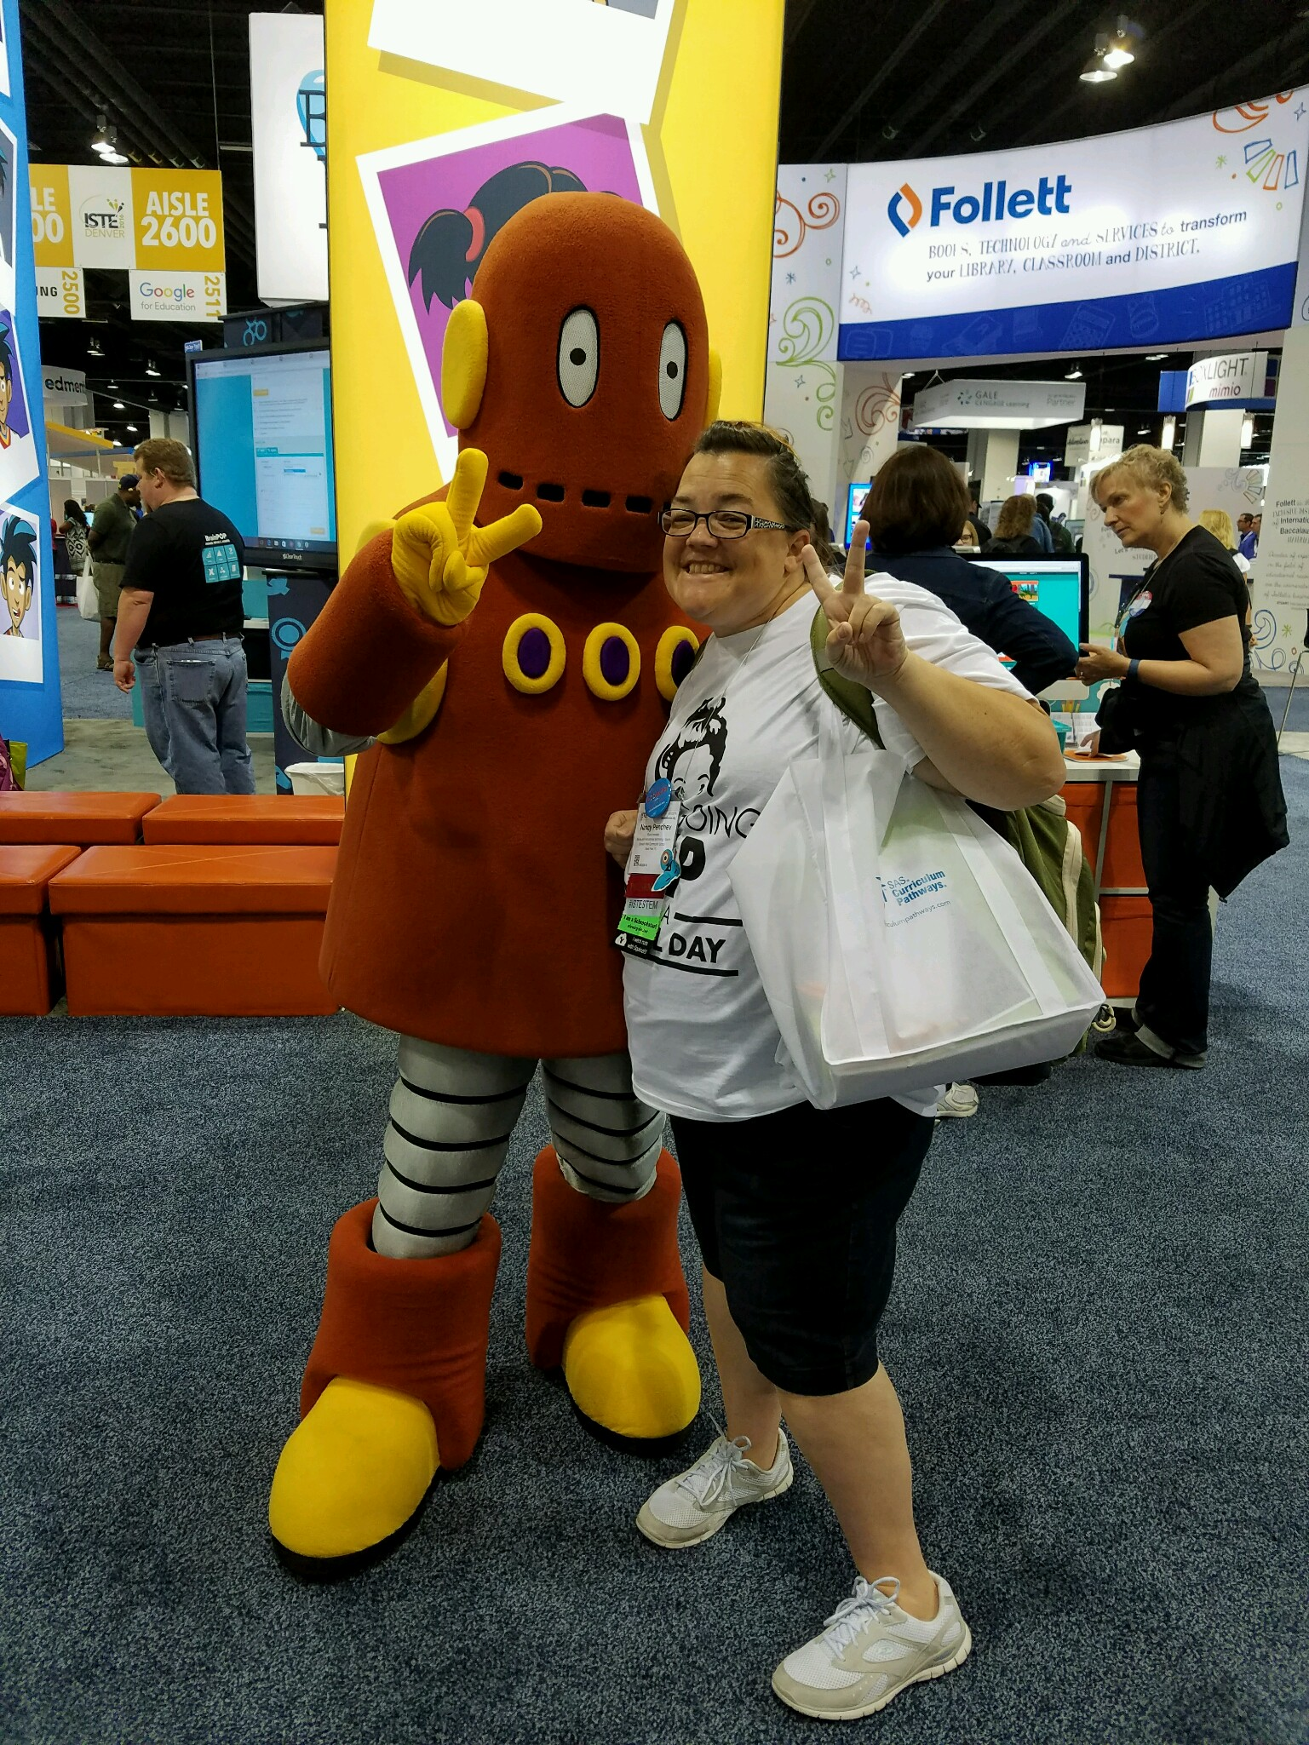
Who am I?
18 years classroom experience K-5
Lifelong learner
An Archeolibrainologist
Children’s book enthusiast
Blogger
Passionate sharer of instructional technology
Best daughter, sister, aunt EVER, pretty good wife

Slide 4
And I am always excited to say...
UMMM I don’t know let’s figure it out!
Favorite quotes:
Too often we give children answers to remember rather than problems to solve.
-Roger Lewin

Slide 5


Slide 6
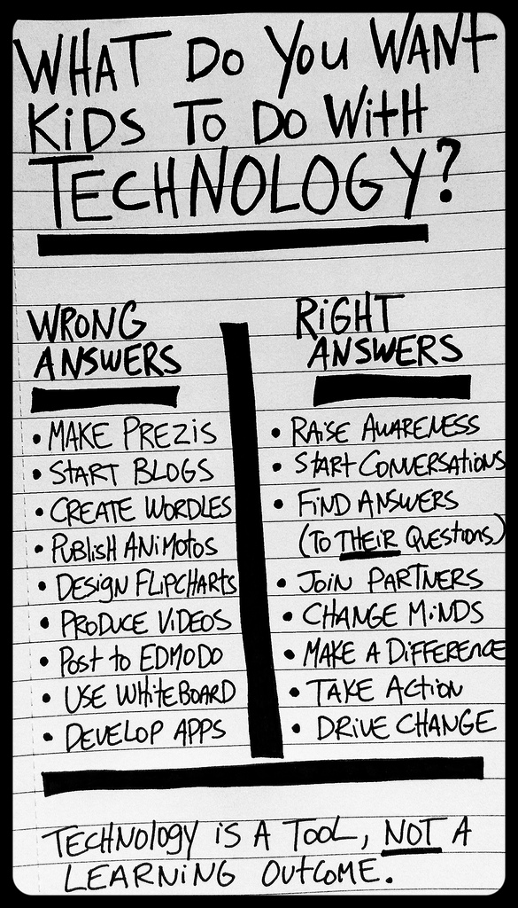
Take a look...
What do you want kids to do?
What do you want to do?

Slide 7
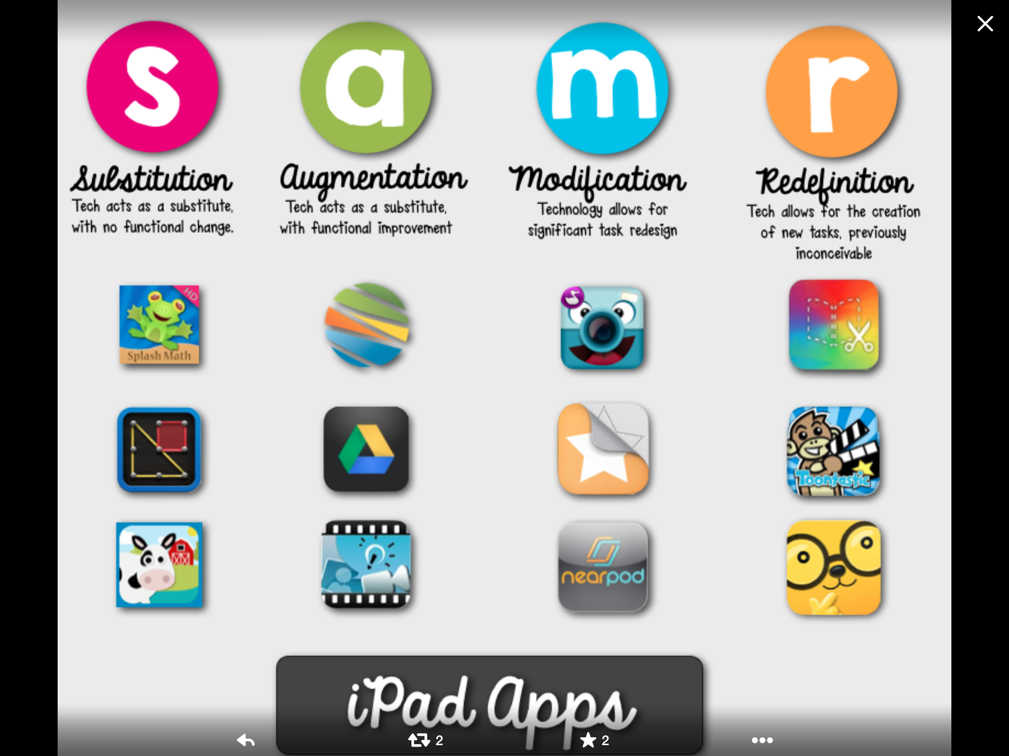

Slide 8
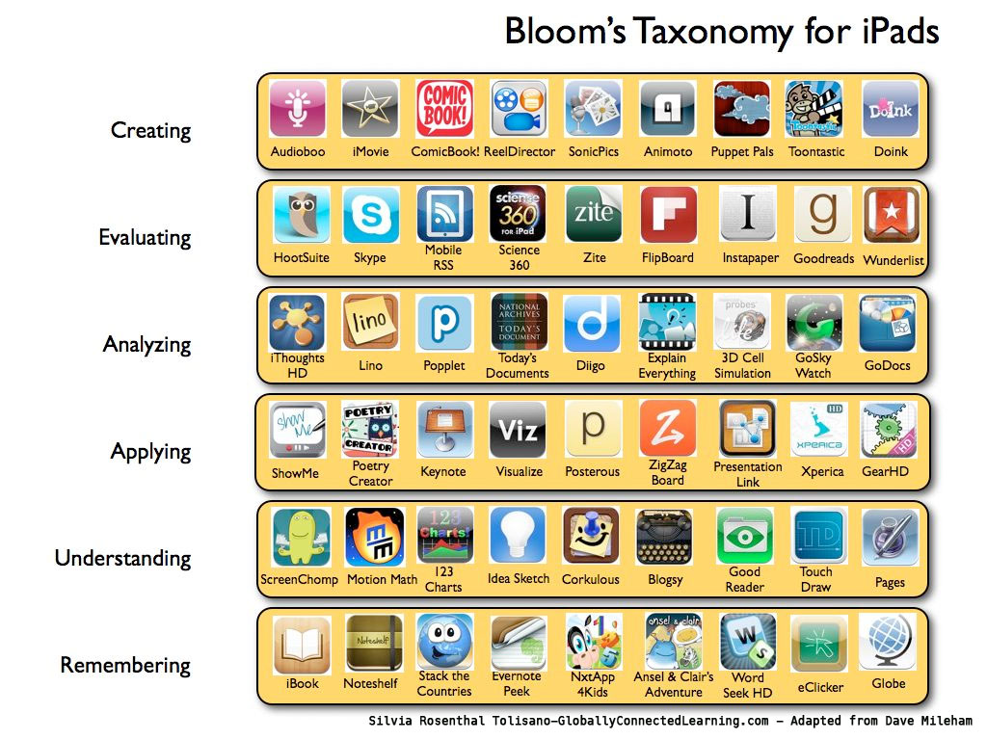

Slide 9
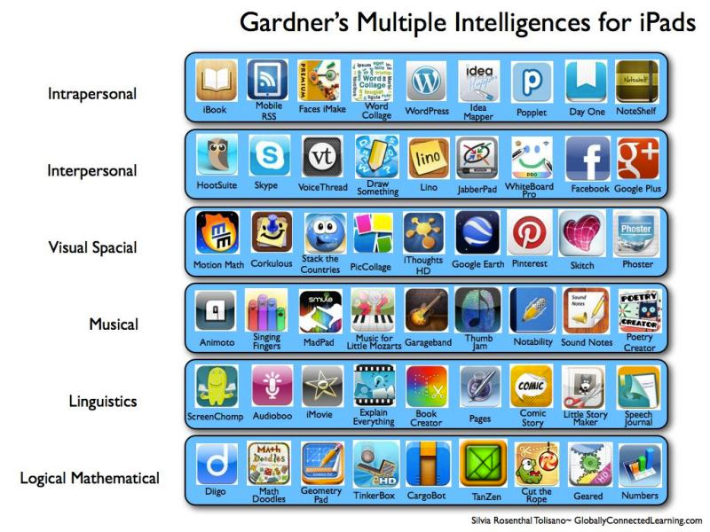

Slide 10
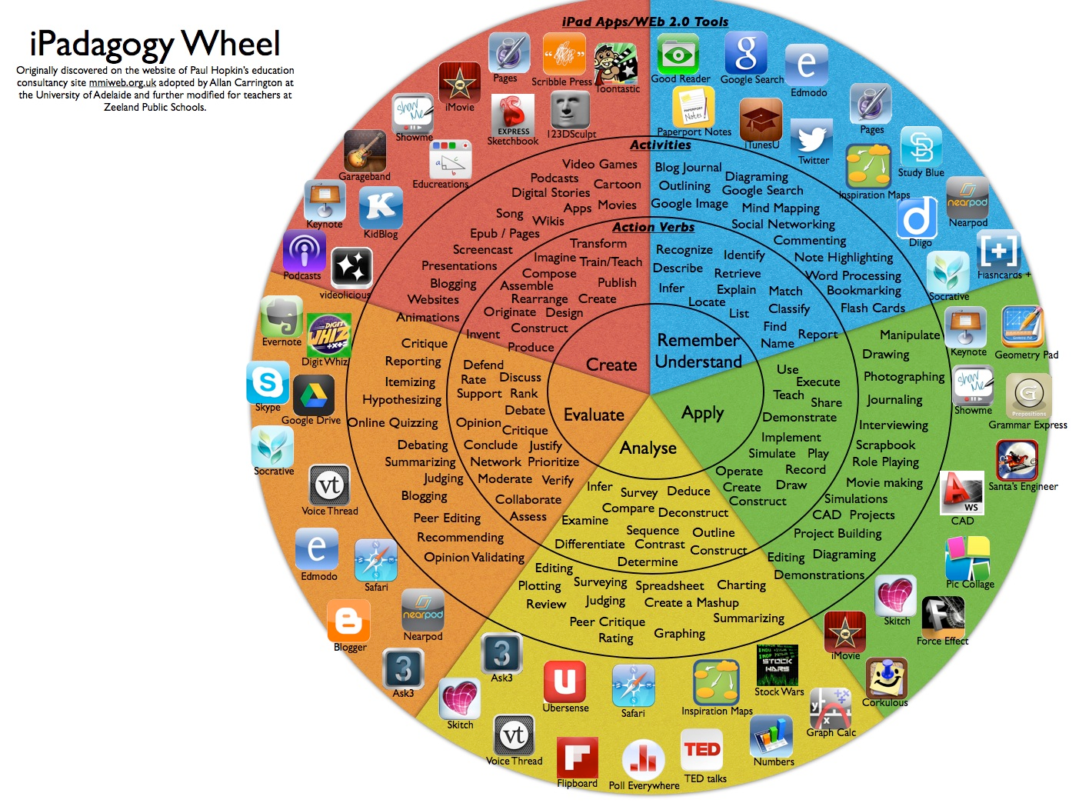

Slide 11
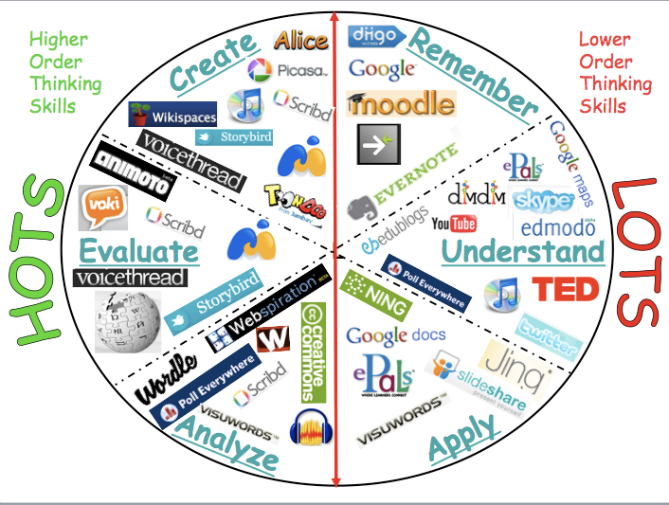

Slide 12
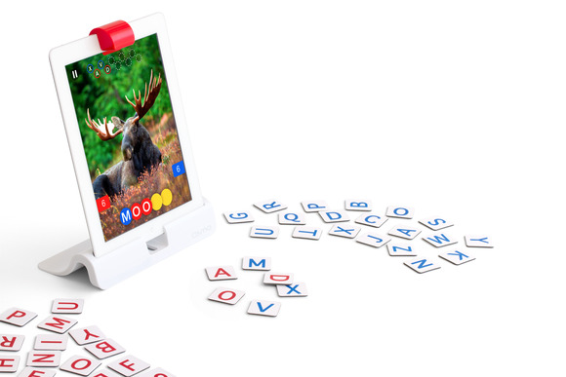
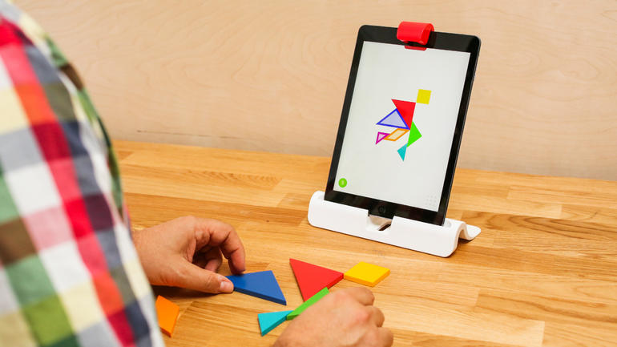
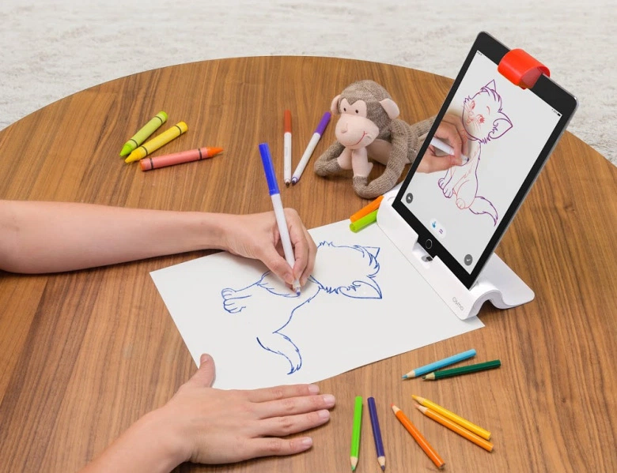
Commercial
OSMO

Slide 13


Slide 14
Each tool will have:
links to my blog posts for this tool
links to the website/APP
links to how to guides for using the tool
links to examples of the tool used in the classroom
similar tools

Slide 15

STOP!!!!!!!!!!!!!!!!!!!!!!!!!!!!!!

Slide 16


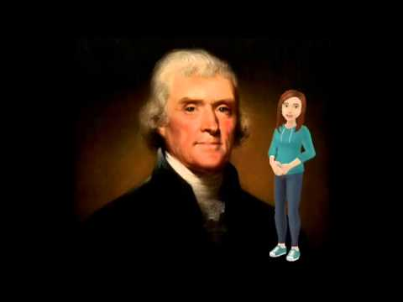

Tellagami
How to Guide
Scholastic article

Slide 17

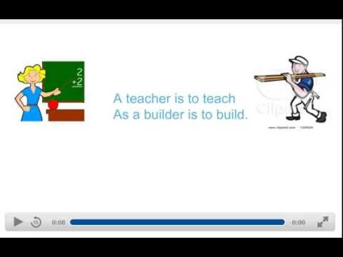
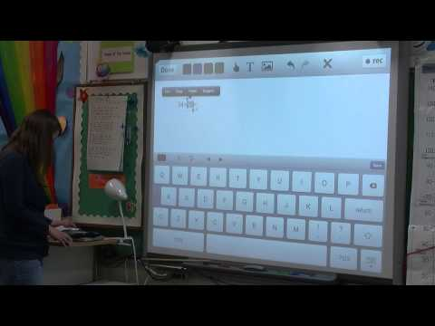
Educreations
How to Educreations
History teacher example
4th graders explain industries in Florida
Amoozing Cattle
Orange Industry
Educreations is a great portfolio tool as well!

Slide 18

Aurasma
Easy 3 step process to create Augmented Reality connections.
Video a book report and link to the book cover.
Youtube example of a book review
How to create by students

Slide 19
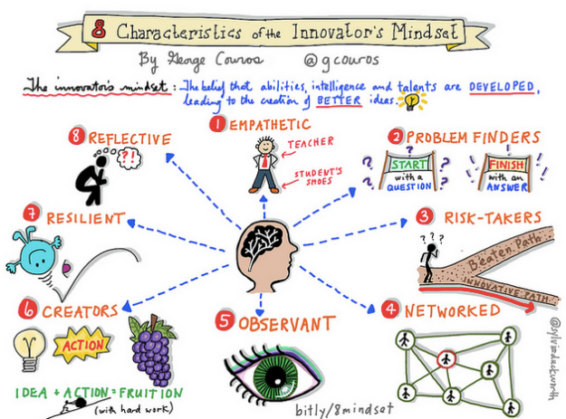

Commercial

Slide 20


Slide 21

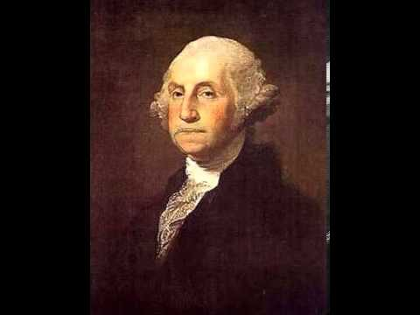


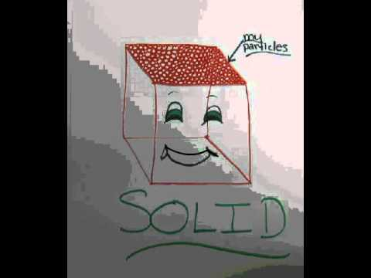
Chatterkids/Blabberize
How to Blabberize
How to Chatterkids

Slide 22
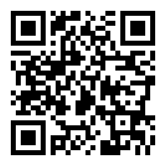
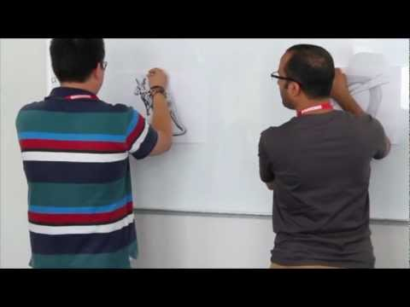
QR codes
How to create QR codes
Amazing resources from a middle school
More great examples from all areas
Literacy centers example

Slide 23

EPIC! Books
Free books!!!!!
Educators are free, can create classrooms, families are $4.99 to support the free-ness of teachers!

Slide 24

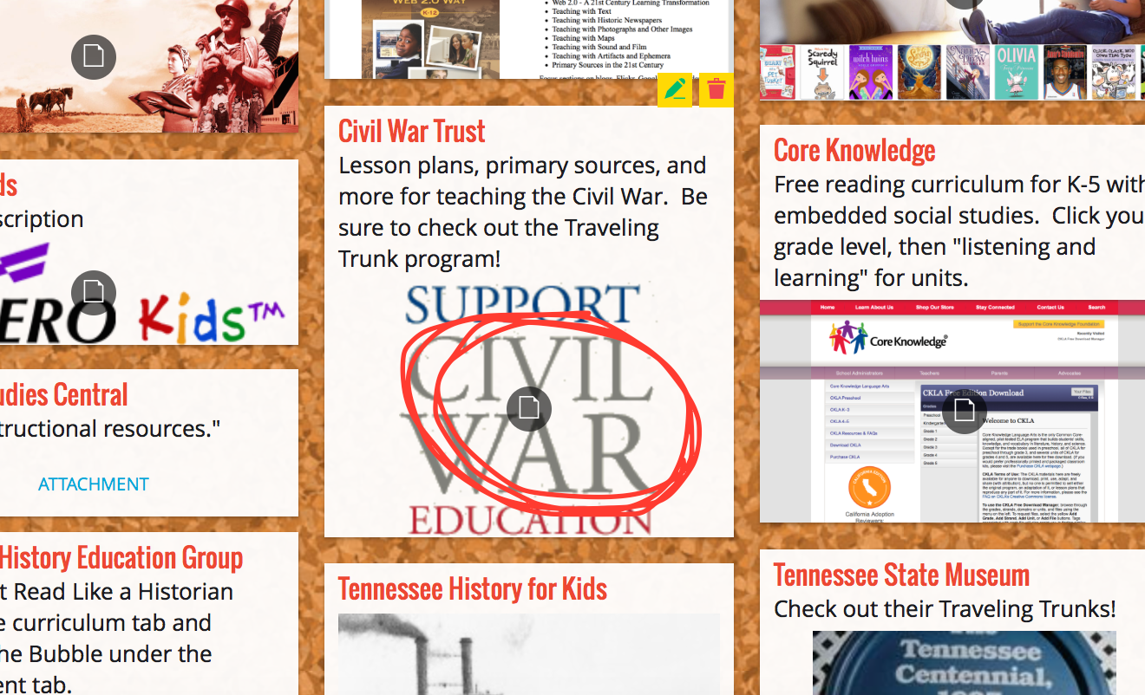
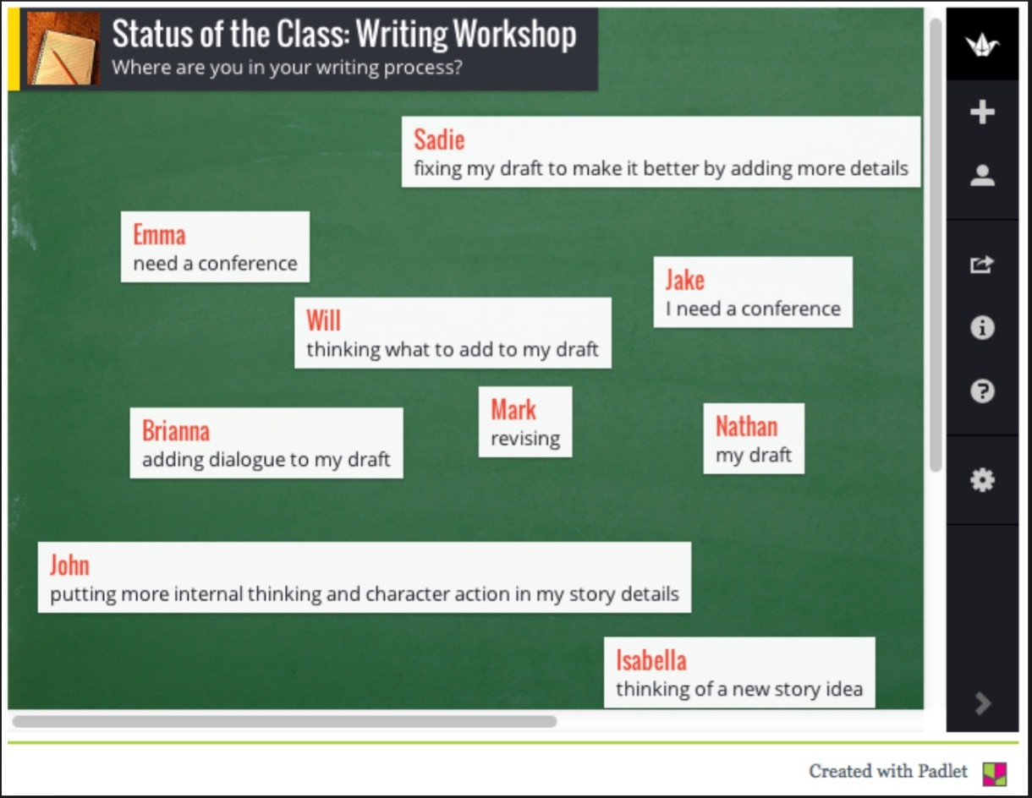
Padlet
How To Padlet
Examples in Social Studies
Reading to writing example
Math class example video
now in APP form!

Slide 25

Commercial: Dot and Dash

Slide 26


Slide 27


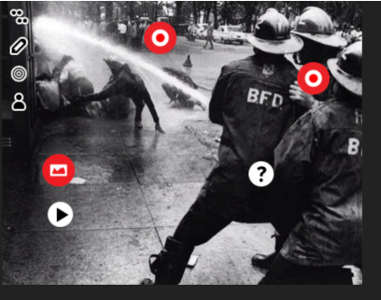
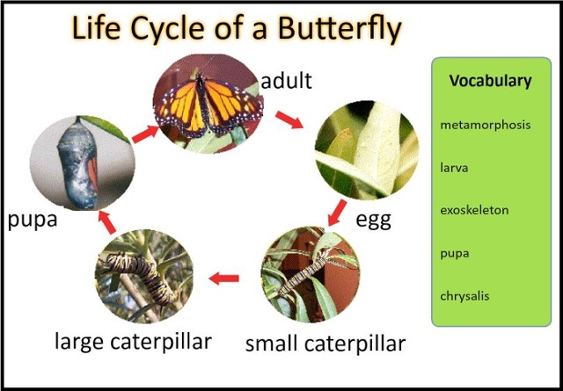
Thinglink
How to Thinglink
Example of Thinglink for Social Studies and Art
Supporting Close Reading with Thinglink

Slide 28

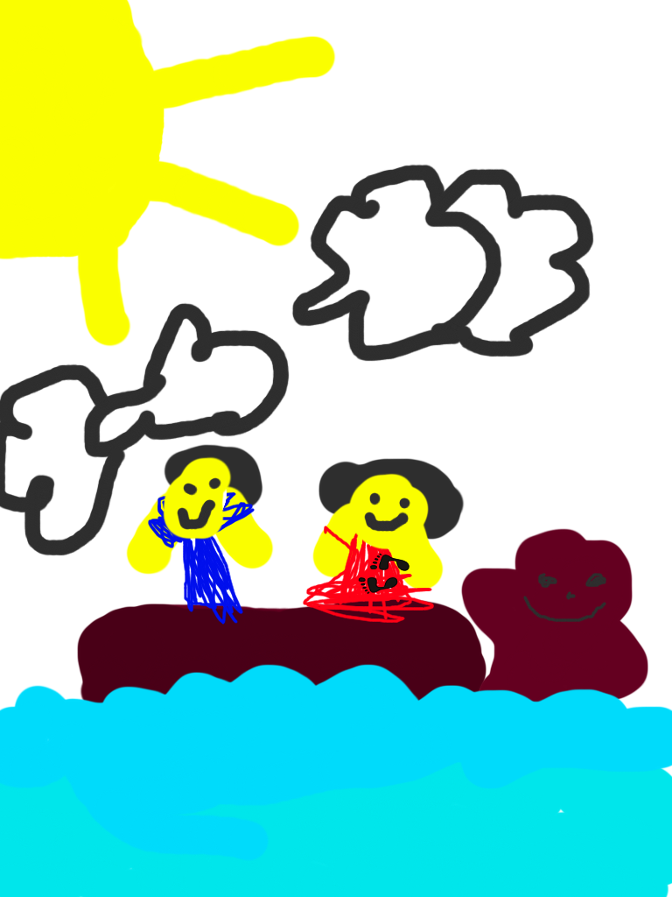
Doodle Buddy
How to Doodle Buddy
Examples of Doodle Buddy
Ideas for literacy classroom

Slide 29
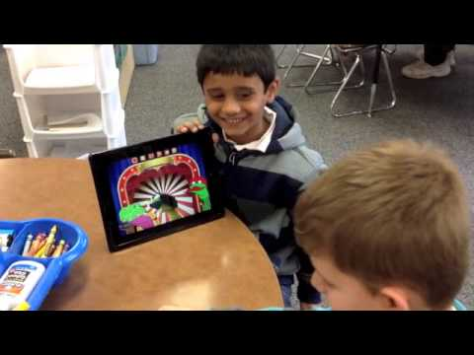


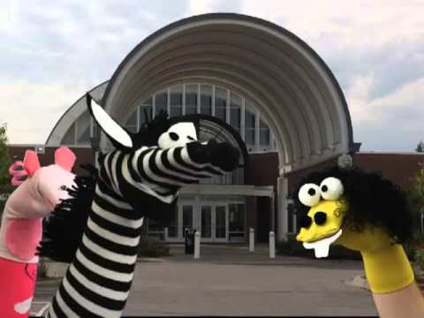
Sock Puppets
How to Sock Puppets
Examples:
Kindergarten retelling stories
Facts about Gettysburg
Introducing class lessons

Slide 30
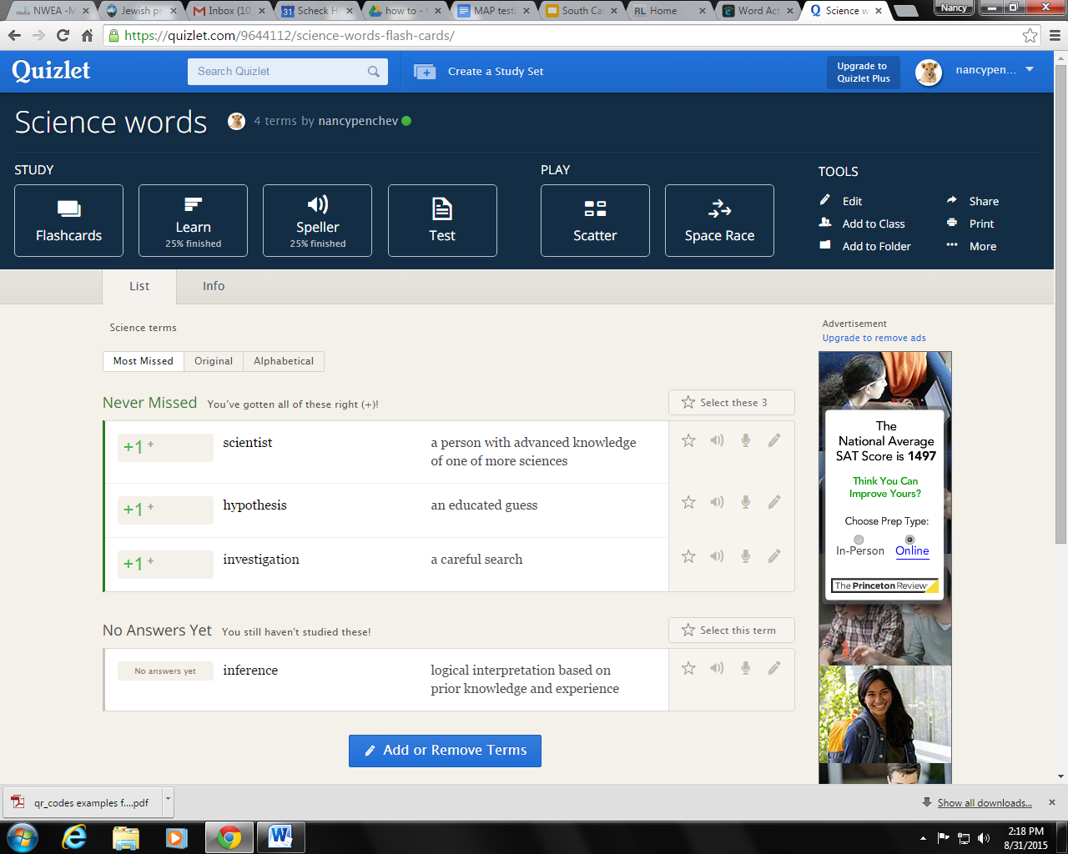
Quizlet
https://quizlet.com/
Quizlet live!!!

Slide 31


Adobe Spark
How to Adobe Voice
Tell your story!
Ideas:
Family history
Retelling favorite stories
Historic facts
Science projects- step by step
*no upload to youtube option

Slide 32



Pic Collage
How to Pic Collage
Literacy ideas- poetry illustrations,
metaphors, similes, sequencing
Blog Post with ideas

Slide 33
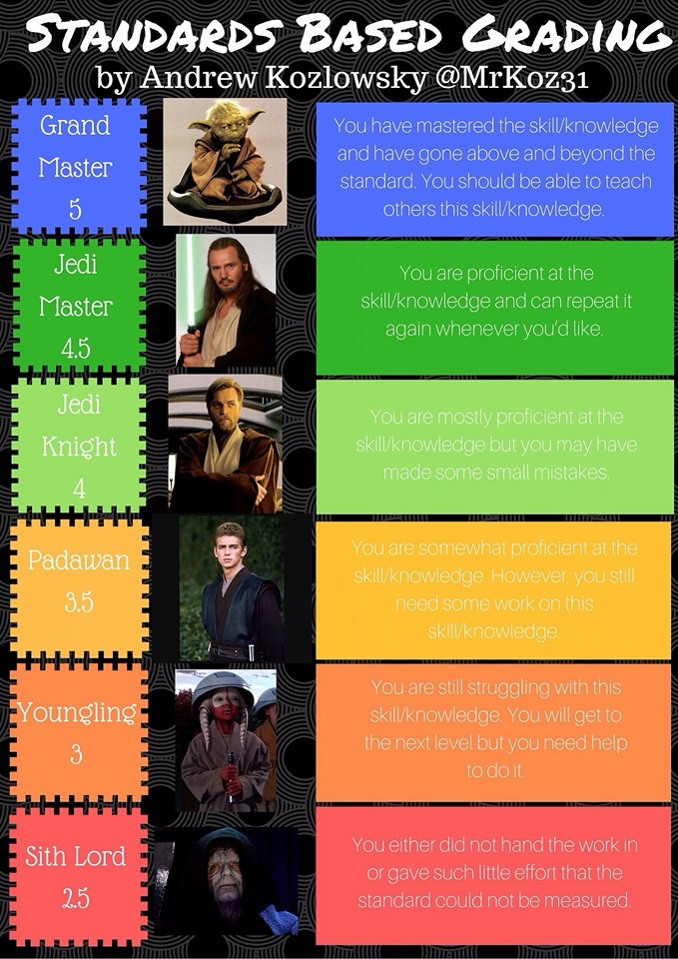

Slide 34


Slide 35
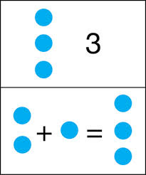



Phonto / PixnTell
How to Phonto How to PixnTell
Ideas for Phonto Ideas for PixnTell

Slide 36
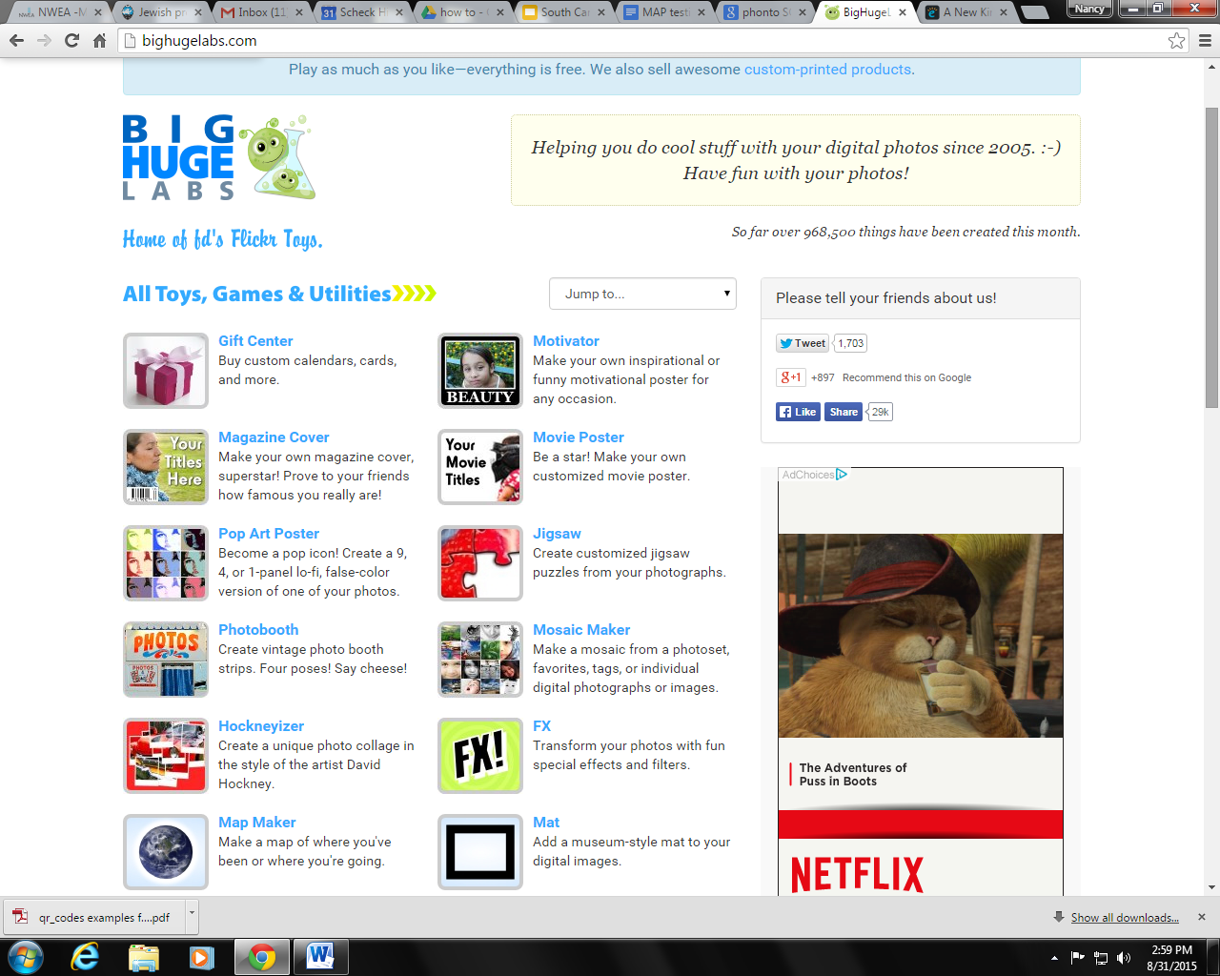
Big Huge Labs
www.bighugelabs.com
Posters Baseball cards
Badgemaker Calendar
Picture cubes CD maker
Bead Art
Idea: Presidential Baseball cards

Slide 37

Twitter
Video how to twitter chat https://m.youtube.com/watch?v=ayfu0s3ypX4
Livebinder with info for twitter http://www.livebinders.com/play/play?id=1144474&backurl=/shelf/my#anchor
Collection of when twitter chats happen http://www.educatorstechnology.com/2014/04/a-list-of-all-educational-twitter-chats.html
TWEECH ME APP $0.99 in the APP store

Slide 38


Shadow Puppet EDU
Ideas
Create mock advertisements
Tell what you would do if you were the book character
Create an author share
Pretend to be a lesser known character in a book and give your side of the events in the book
Summarize a book’s beginning, middle, and end
check out http://get-puppet.co/education/
How to Shadow Puppet EDU
Video Tutorial
High school example

Slide 39

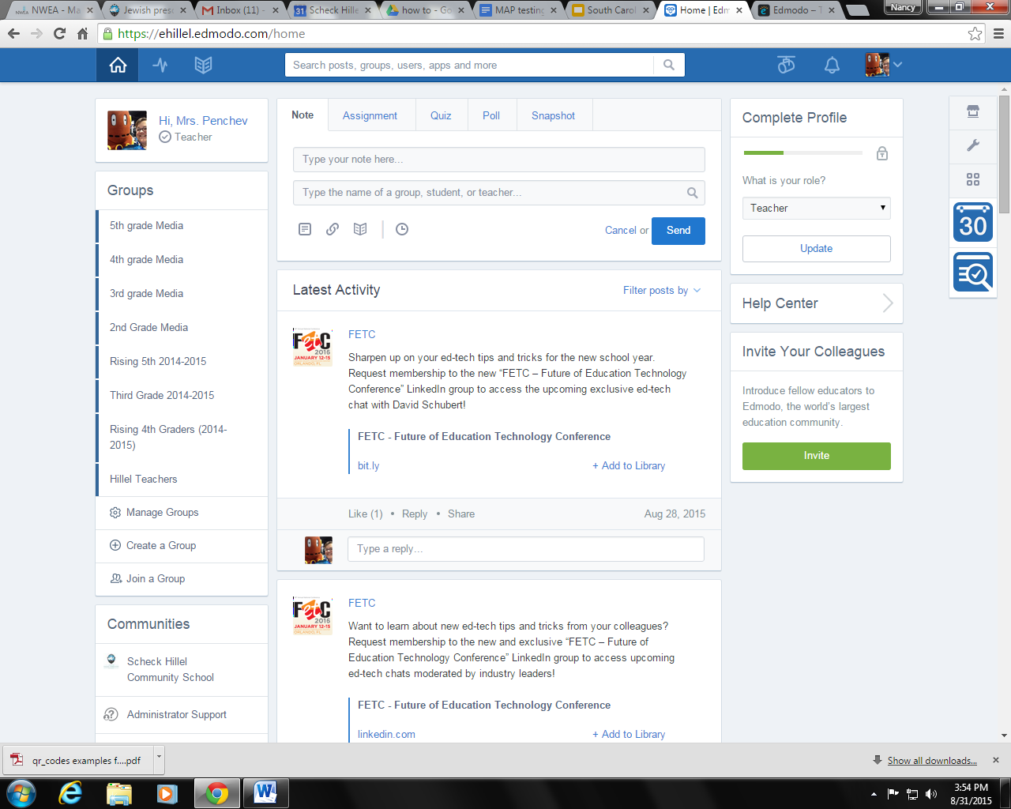
Edmodo
A social learning platform

Slide 40

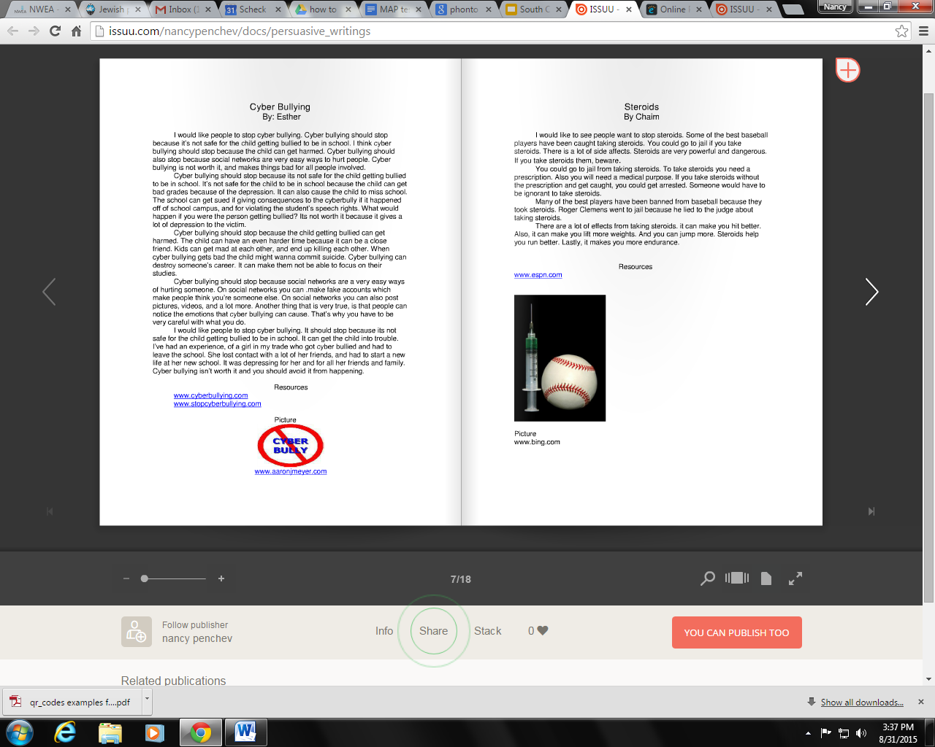
Issuu
In this program you can make
magazines, journals, books, and
so much more. It offers public or
keep it private. I created one with
my student’s persuasive essays.

Slide 41

Edublogs
Share your students’ writing with the world.
Book reviews
How to blog

Slide 42

Snap n Write
How To
Reading ideas:
Postcards to a friend about the book
Letters to the author/character
Persuasive postcard to bookstore to carry the book

Slide 43

Kahoot
Mrs E blog post with directions
Video in classroom
Let’s Play!!!

Slide 44
Commercial
Something to consider?
ToggleTalk by Ventris Learning
Uses children’s books to teach students the value of using Standard English over “home language”
http://www.ventrislearning.com/toggletalk/

Slide 45
Low Tech/No Tech options
Sometimes you just don’t have the tech or time….

Slide 46
Social Media walls
Have students create profiles for leaders in history. Include their friends, personal info, ideals they support. #ContinentalCongress
Have students create 140 character reports as if they are the character #IamHarry
Have students select the antagonist and explain their point of view and create a fakebook profile for them #notthebadguy
Have a chat with a person from history, asking questions, and building/sharing knowledge @Sacajawea
Post questions you have for an author #authorchat
Examples of parts of speech found around the classroom #foundanoun
Math shapes found around school #circle #square #triangle OR #perimeter=36 in.

Slide 47
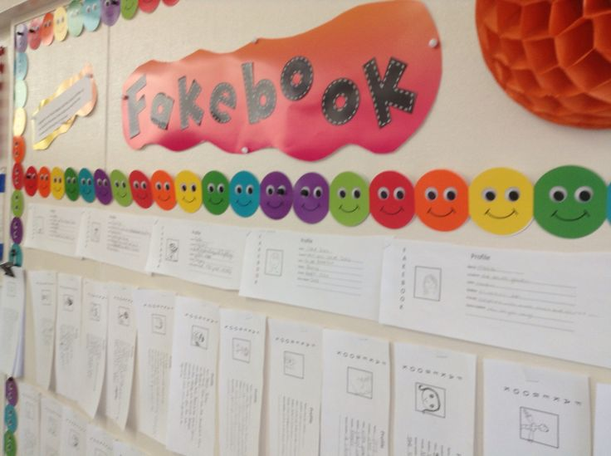
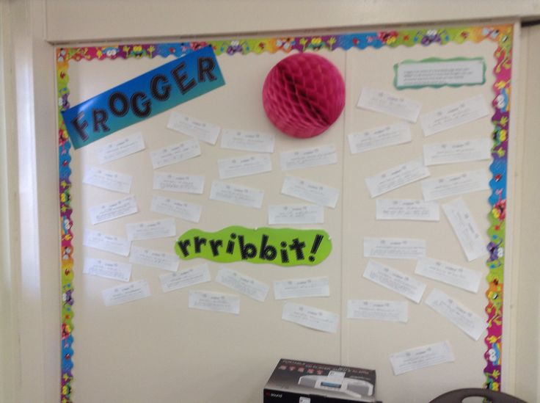

Slide 48
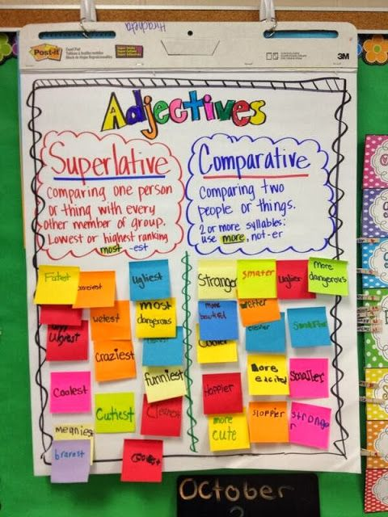
Sticky blogs
A teacher/student selects a topic to discuss and writes the idea on the top of a chart paper that is attached to a table. Students use sticky notes to respond and reply to the topic.
Should the colonies leave the protection of England? pros/cons
Predictions for cliffhanger stories
What will happen in the next book

Slide 49
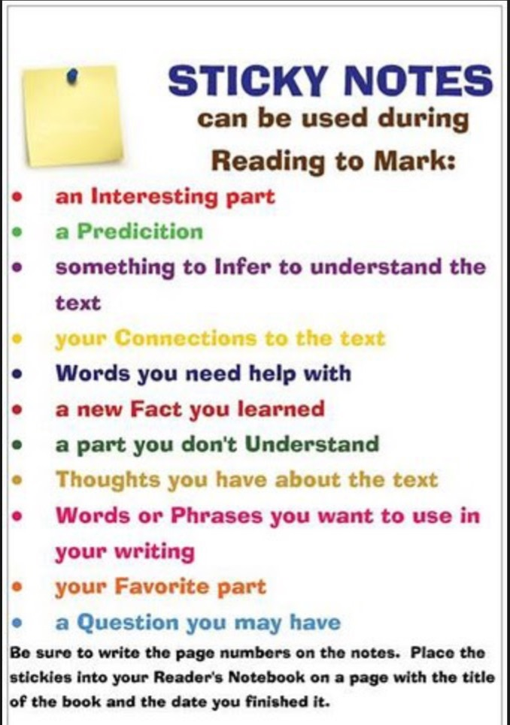

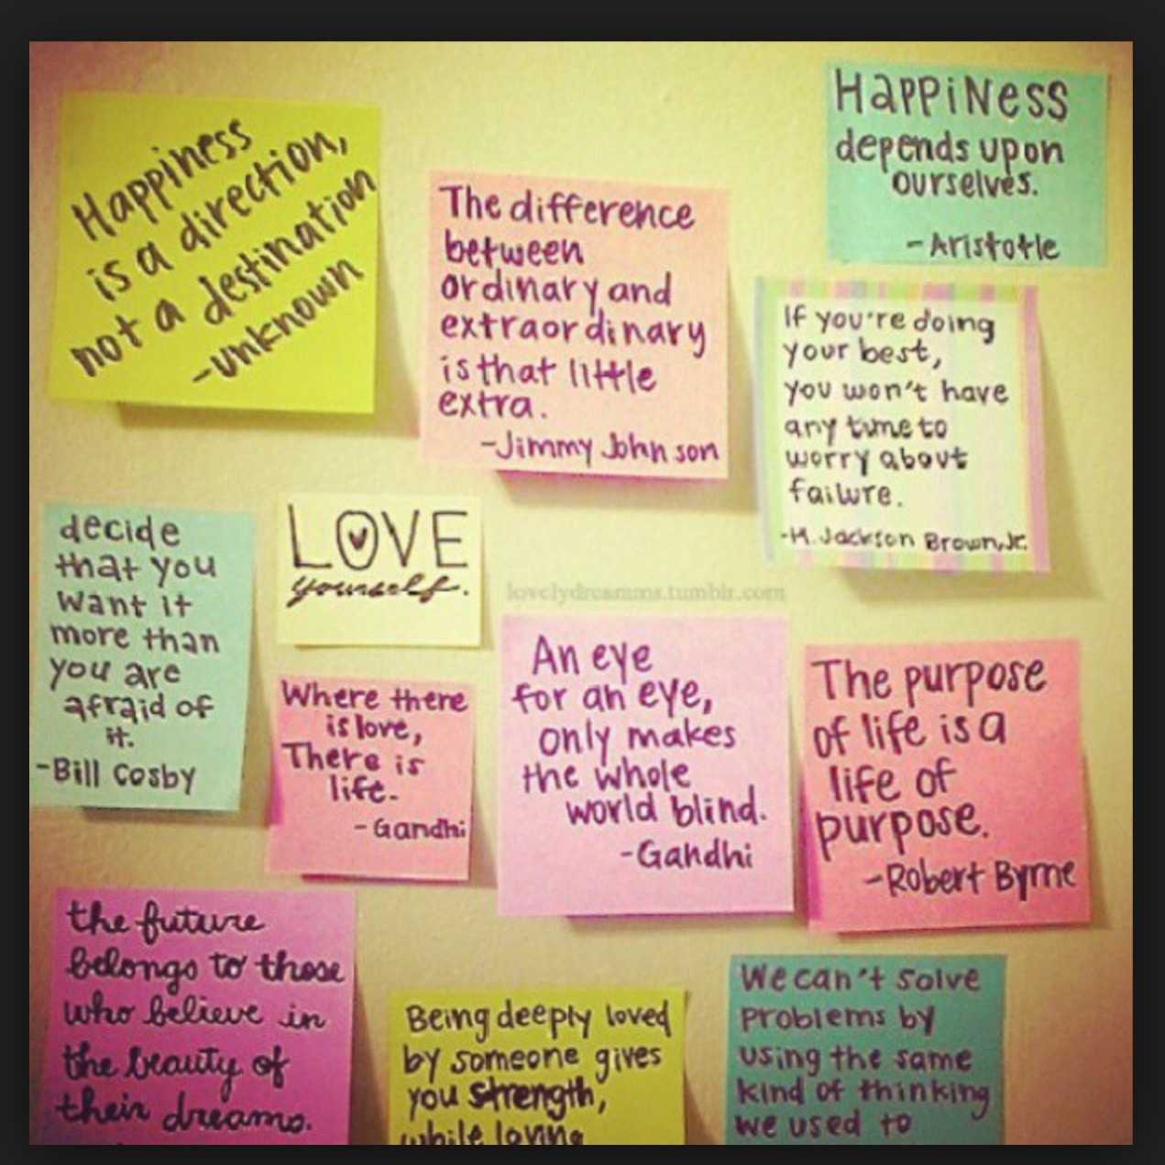
Polls
Poll students about their feelings,
thoughts, learning, and more!

Slide 50

Plickers
Plickers
Plickers is a powerfully simple tool that lets teachers collect real-time formative assessment data without the need for student devices.
Pinterest board for plickers

Slide 51

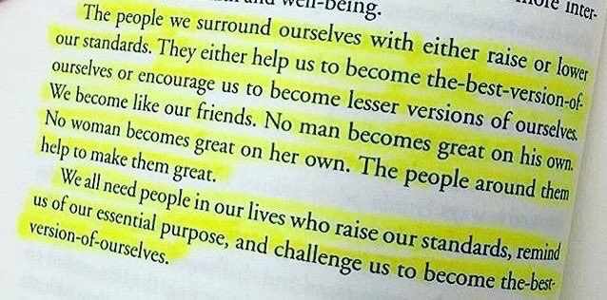
Commercial:
Kids Deserve It

Slide 52
Where can I find out about all this stuff?
www.nancypenchev.edublogs.org
www.freetech4teachers.com
http://blog.web20classroom.org/
http://www.livebinders.com/play/play?id=108629
TWITTER!!!!!!! EdCamps! Connected Educators know!

Slide 53
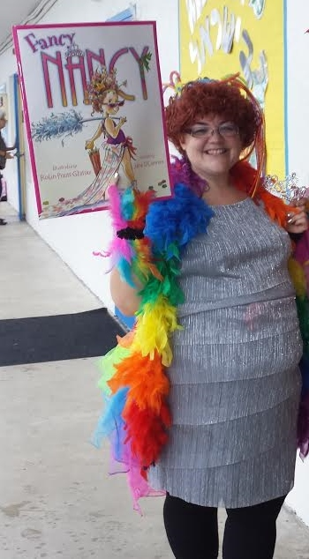

Questions?

Slide 54
Don’t forget!
www.nancypenchev.com
www.nancypenchev.edublogs.org
nancypenchev@gmail.com
Twitter: @penchevable

