Slide 1
Contact info
www.nancypenchev.com
www.nancypenchev.edublogs.org
Twitter: @penchevable
nancypenchev@gmail.com

Slide 2
Girls Building STEAM
Exciting girls about STEAM fields
Nancy S Penchev

Slide 3
Want a prize?
*Your favorite STEAM activity
*A writing prompt that is STEAM related!
*A website or app that is STEAM-rific!
*Your favorite woman of inspiration in a STEAM field
Tweet me @penchevable
or fill out a pencil slip with one of the following:

Slide 4
Go to
www.nearpod.com
code RSTIL

Slide 5
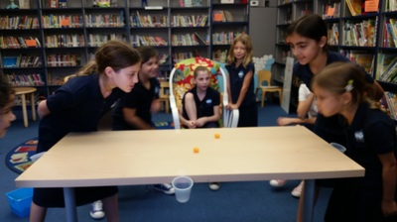
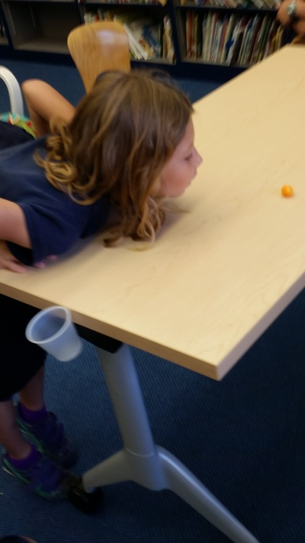
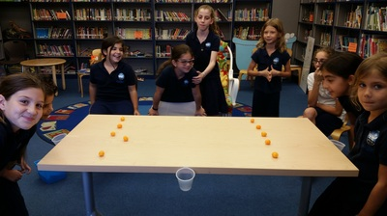
C
H
E
E
S
E
B
A
L
L
S

Slide 6
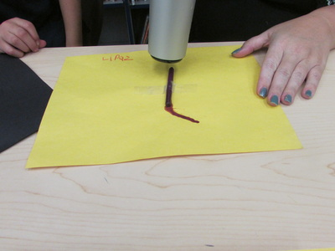
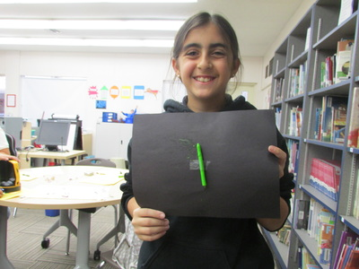
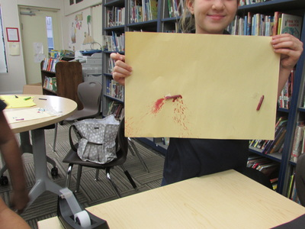
HEAT

Slide 7
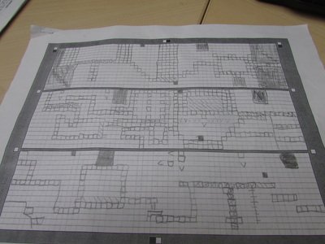
Floors

Slide 8
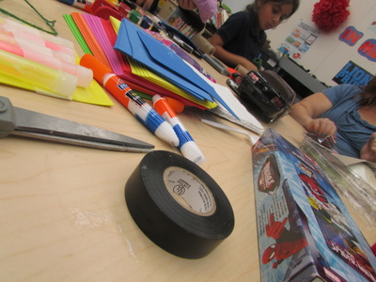
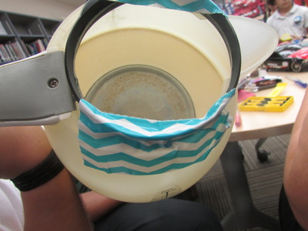
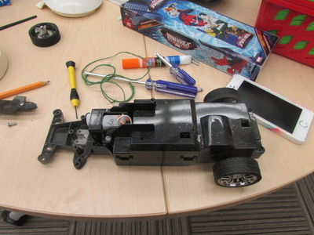
MAKER

Slide 9
WHY?

Slide 10
Thanks to...
NearPod
ImagineEasy
Science4us.com

Slide 11
Want to play?
Come check out some cool stuff!

