Slide 1
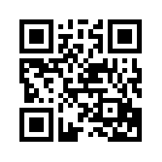
Sharing our ideas
Twitter
@penchevable #fame15 #literacydays
Google doc http://bit.ly/1KsiA7o
The presentation is at www.nancypenchev.com

Slide 2
Have Fun and Engage Students in Literacy
FAME 2015
Nancy Penchev
www.nancypenchev.com
*presentation is located here

Slide 3
Ways to find me
www.nancypenchev.com
www.nancypenchev.edublogs.org
nancypenchev@gmail.com
Twitter: @penchevable

Slide 4
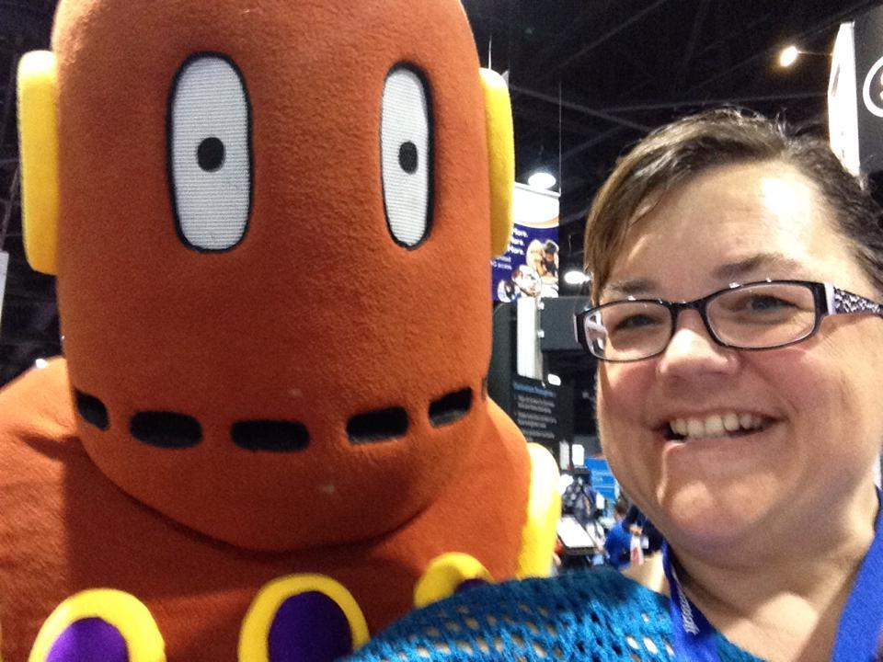
Who Am I?
18 years classroom experience K-5
Lifelong learner
An Archeolibrainologist
Children’s book enthusiast
Blogger
Passionate sharer of instructional technology
Best daughter, sister, aunt EVER, pretty good wife

Slide 5
And I am never afraid to say...
UMMM I don’t know let’s figure it out!
Favorite quotes:
Too often we give children answers to remember rather than problems to solve.
-Roger Lewin
There’s no crying in baseball
-A League of Their Own

Slide 6
Literacy Days
In the beginning….Dr Seuss’s birthday

Slide 7
Dr Seuss #2: morals and lessons learned from Dr Seuss’s books
The Foot Book: We are all different and it’s ok!
Activities: fizzy footprints (reading directions), feet charades (acting out parts), personal connection to being different

Slide 8
What Was I Scared Of? (Glow in the dark)
Activities: Draw something you thought was scary, transform into not scary, Trusting team members, personal connection to overcoming fears

Slide 9
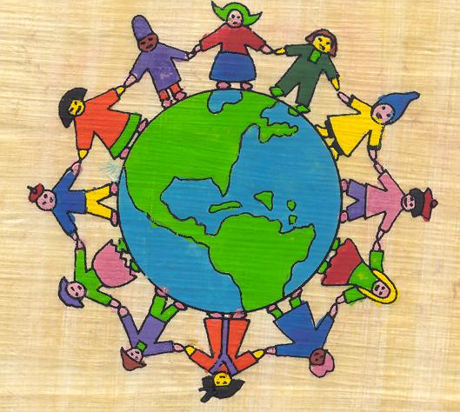

Slide 10
Around the World
Children were surveyed about country of origin. Then activities were built based on top countries.
Teachers selected the countries they wanted, many of them were from those same countries.

Slide 11
Activities
South Africa
Marriage of the Rain Goddess is about a rain goddess named Mbabo Mwana Waresa who live in the clouds and was lonely. She wants someone that is worthy of her love. From the sky, Mbabo looks down and sees a happy cattle herder, Thandiwe. She sends him love letters with her colorful beads. For our activity, we will have our students make a beaded bracelet and draw a colorful picture.
Russia
Story about The Magic Gold Fish. Students will be rotating between stations learning about the Russian culture, currency,clothing, food.

Slide 12
Venezuela
I will be reading in Spanish and English the legend Wings and Dreams: the Legend of Angel Falls. We will play Venezuelan music. In smaller groups, we will show them crafts and items typical of the indigenous people of Venezuela, play a bingo game, read other books in Spanish.
Canada ABCs- A book about the people and places of Canada
The students will complete a package about Canada that they may take home (color the flag, Canadian vocabulary, Canadian word search..etc)
Colombia
Tell The Legend of the Colombia Mermaid. It dates back to 1917 and tells the story of a young girl who defies her parents and went swimming in the river on Good Friday. We will also do a scavenger hunt and create a book on Colombia.

Slide 13
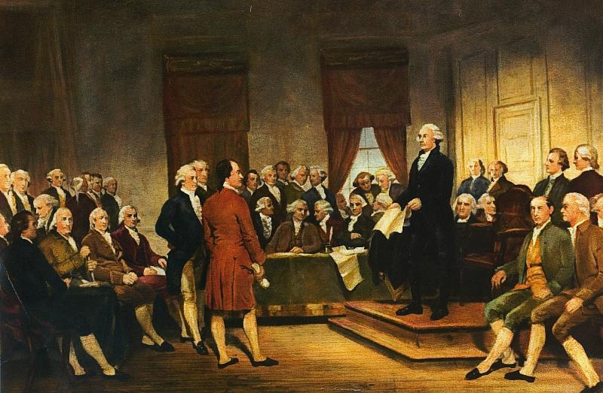

Slide 14
Constitution Day
*Each child traced their hand in a certain color and wrote how they planned to be a good citizen. We put them all together to create the American flag.

Slide 15
Constitution Day
Responsibility quilt- each person gets a square and designs a good citizen, put together for a class quilt
Read We, The Kids
Says/Is/Helps Chart what the Constitution says, what it is, how it helps
Create a word cloud with the words of the constitution preamble or can make a low tech paper version http://www.abcya.com/word_clouds.htm
GREAT game Madison’s Notes are missing - take on a character from history and share their thought on the creation of the Constitution
http://billofrightsinstitute.org/resources/student-resources/play-games/madisons-notes-are-missing/

Slide 17
Math Literacy Day #1
Author Visit
David Schwartz

Slide 18
Math Literacy Day #2
K/1: Ten Black Dots, 93 in My Family
2: How Big is a Foot, Alexander Who Used to Be Rich Last Sunday
3 : Zero the Hero, The Doorbell Rang
4: The Great Graph Contest, What’s Your Angle Pythagoras
5: Sir Cumference and All the King’s Ten

Slide 19
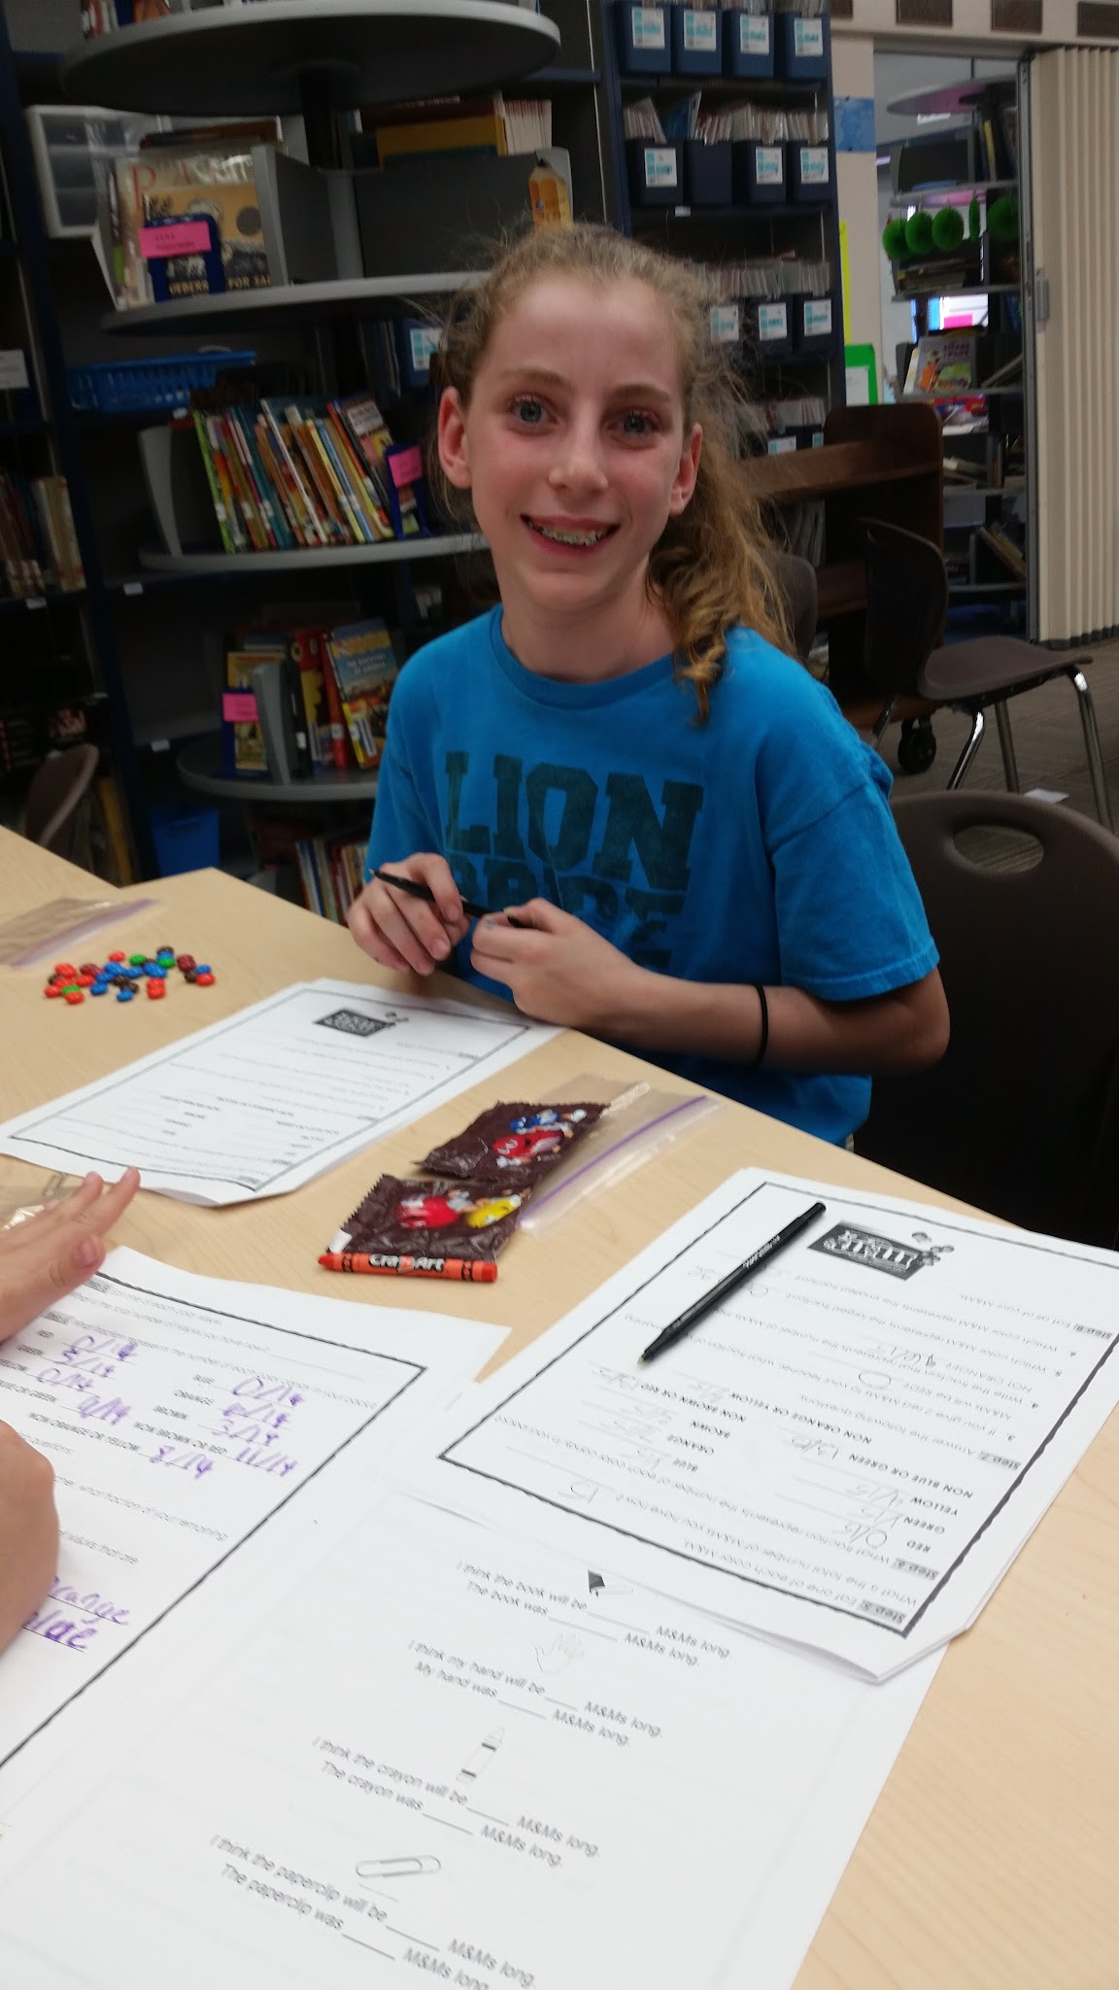
Activities
*Each grade had a snack activity (graphing M&Ms, sorting cereal, etc.)
*The idea was FUN math/reading!
*TONS of Math Literacy ideas

Slide 20
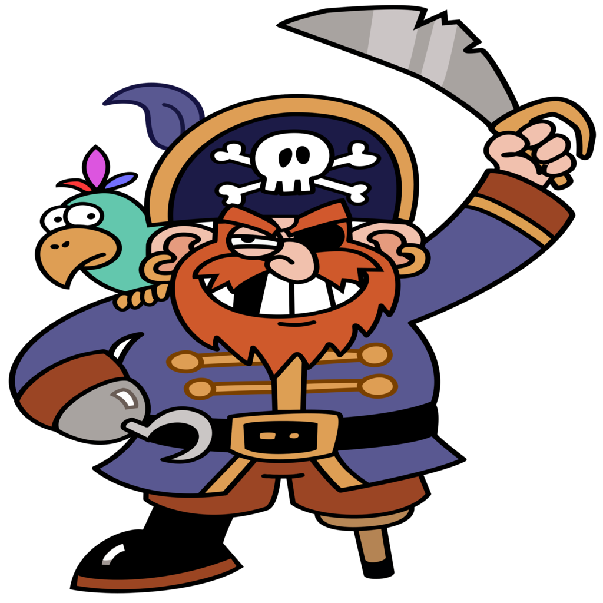

Slide 21
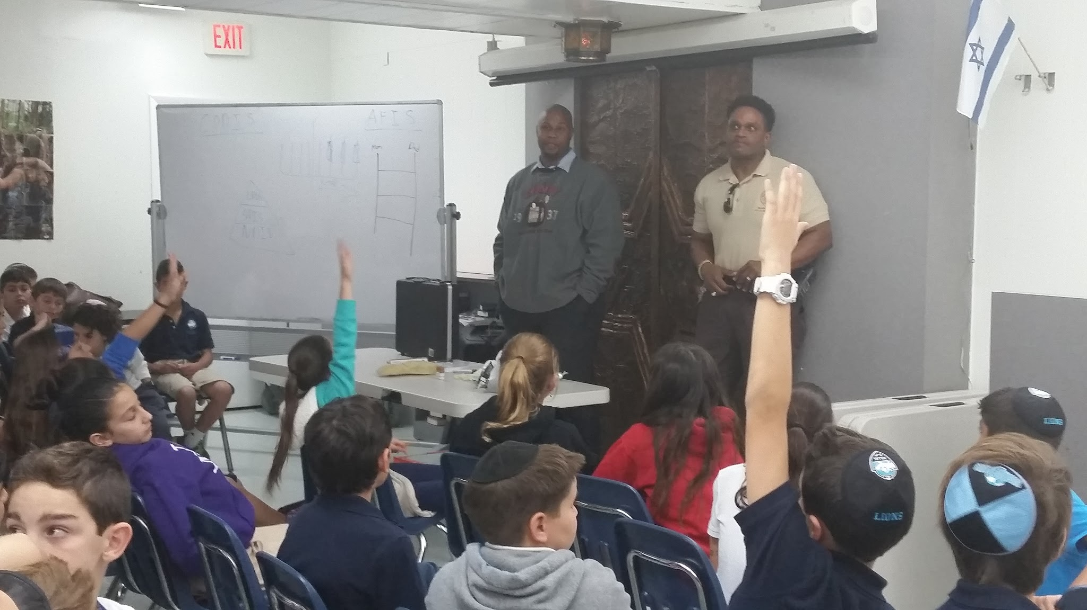
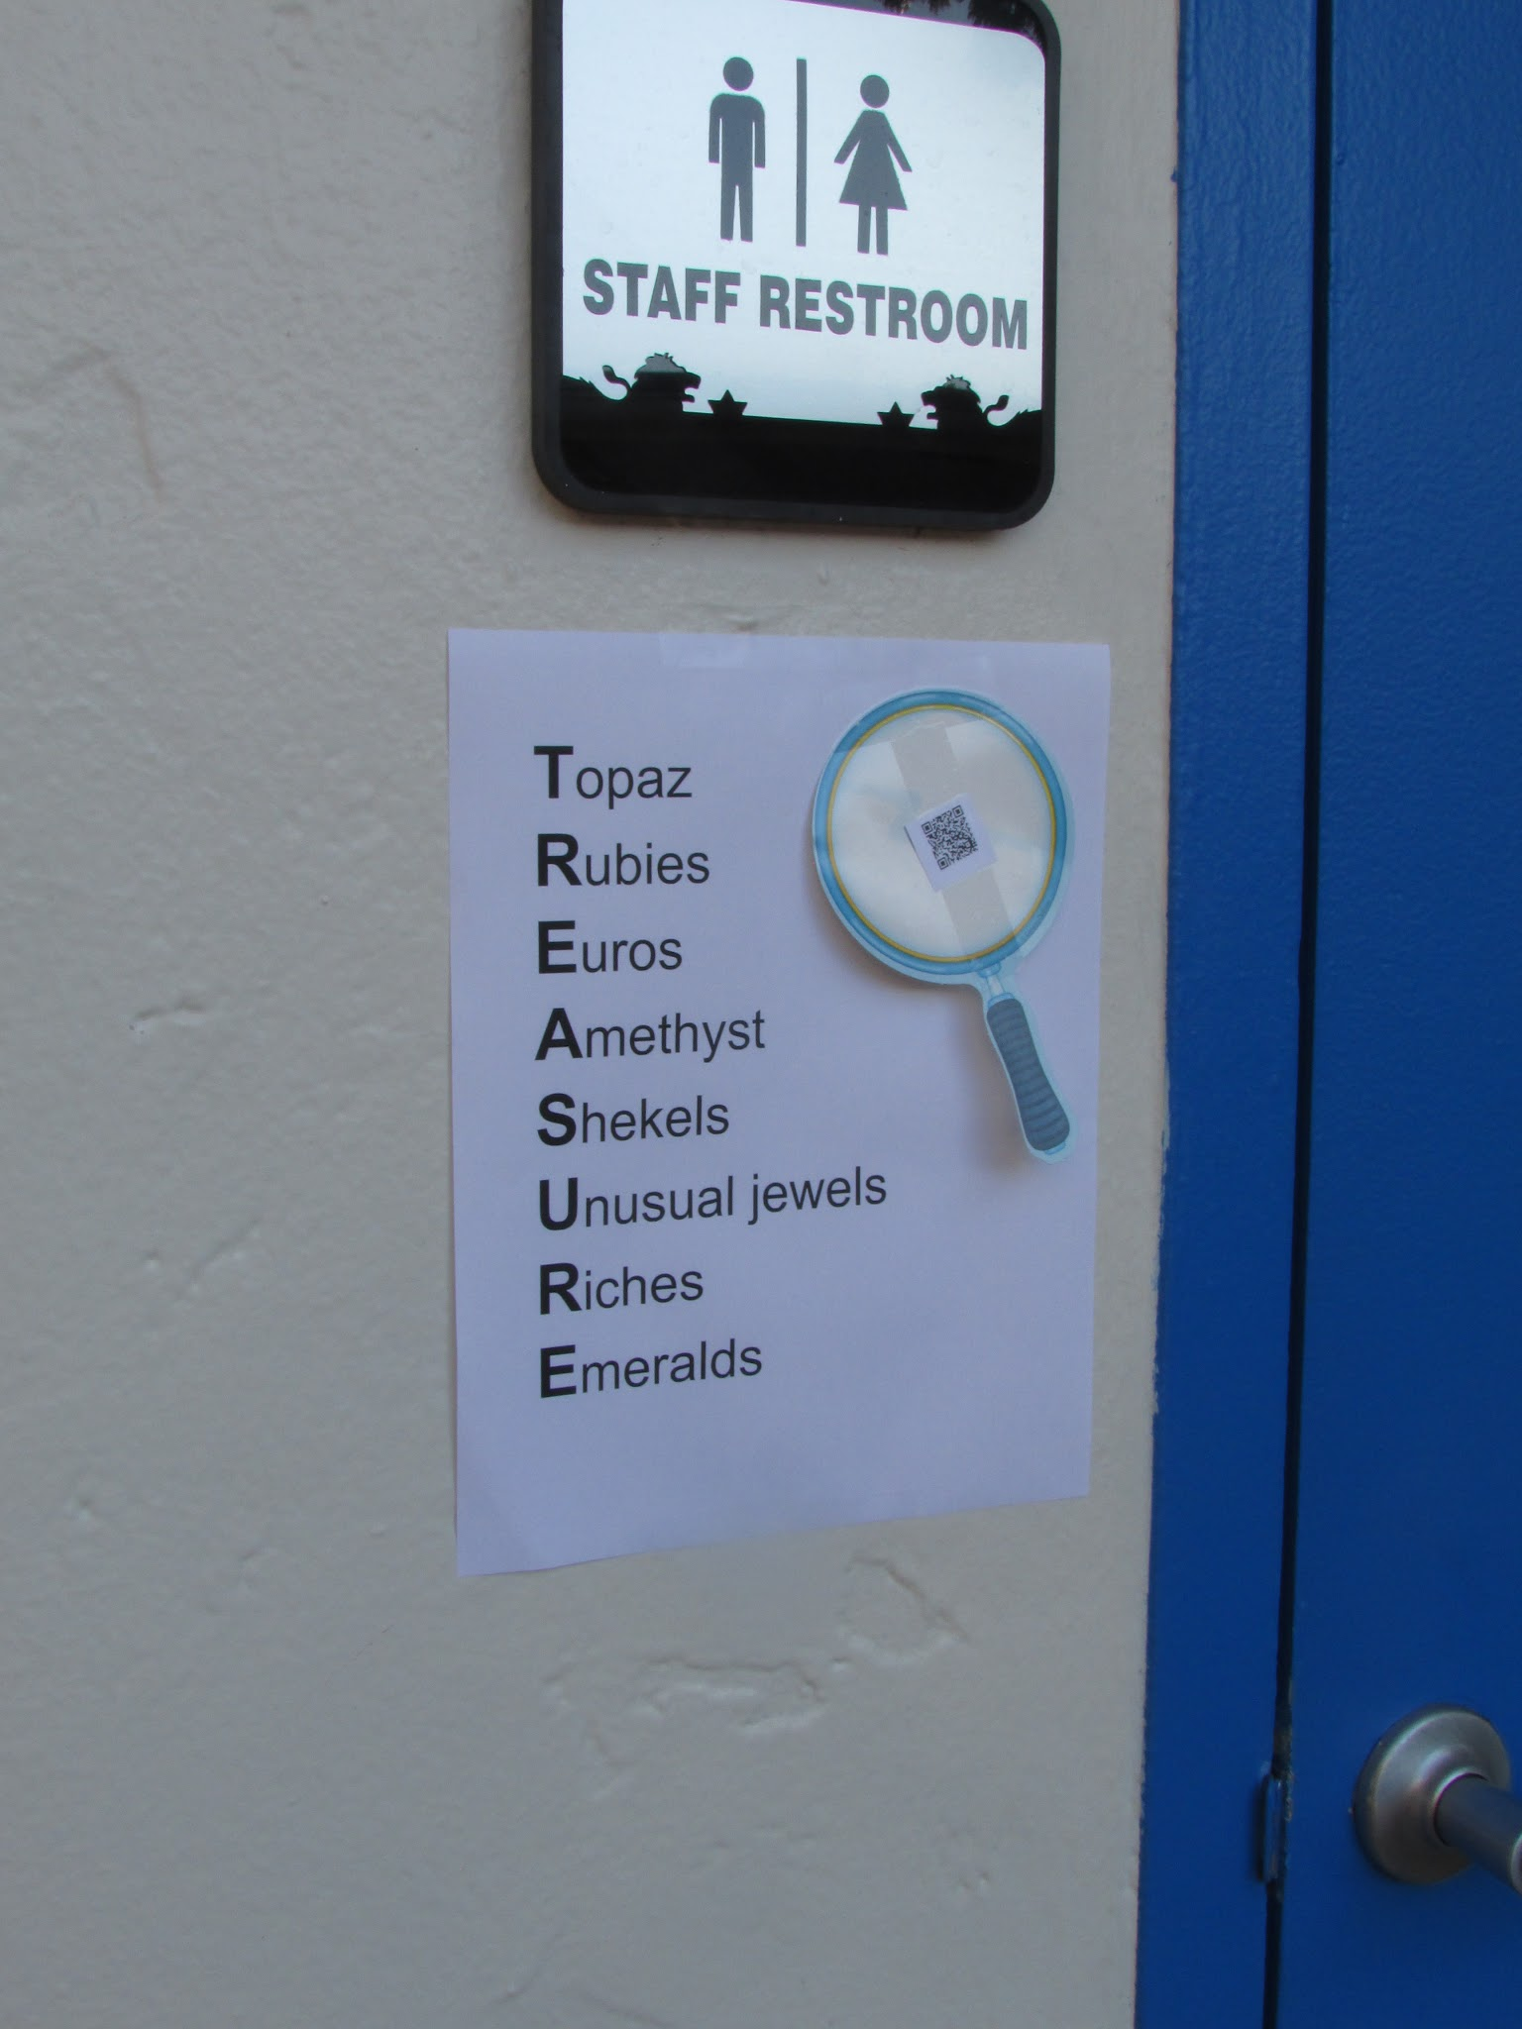
Pirate Mystery Literacy
*Kids chose the theme and gave ideas for activities.
*Pirates….Mysteries…CSI

Slide 22
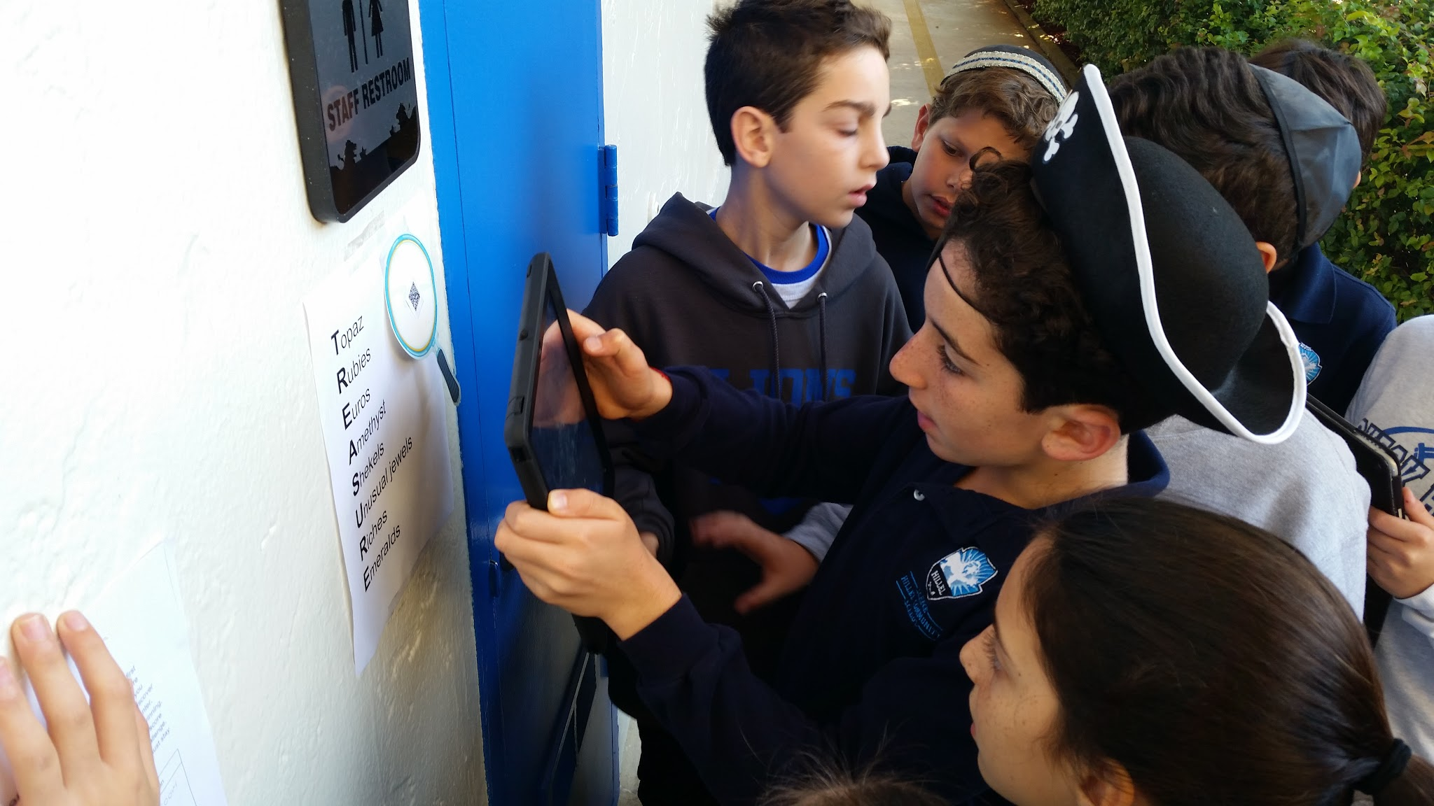
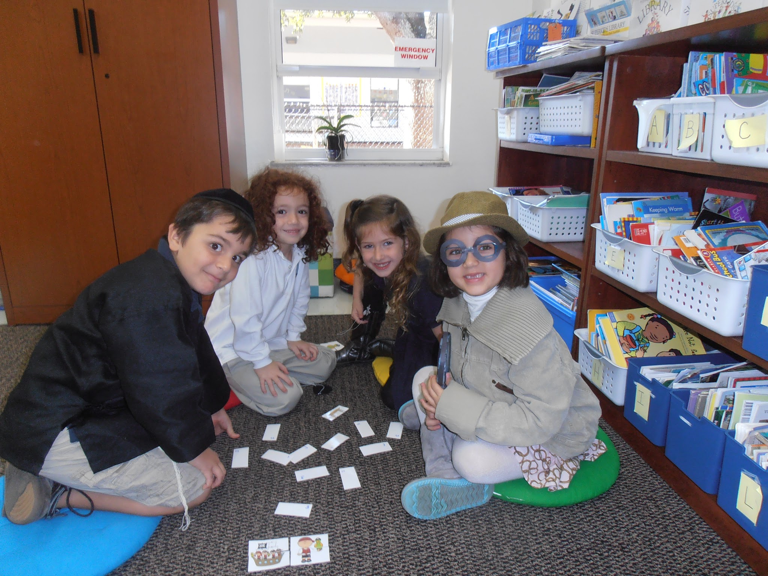
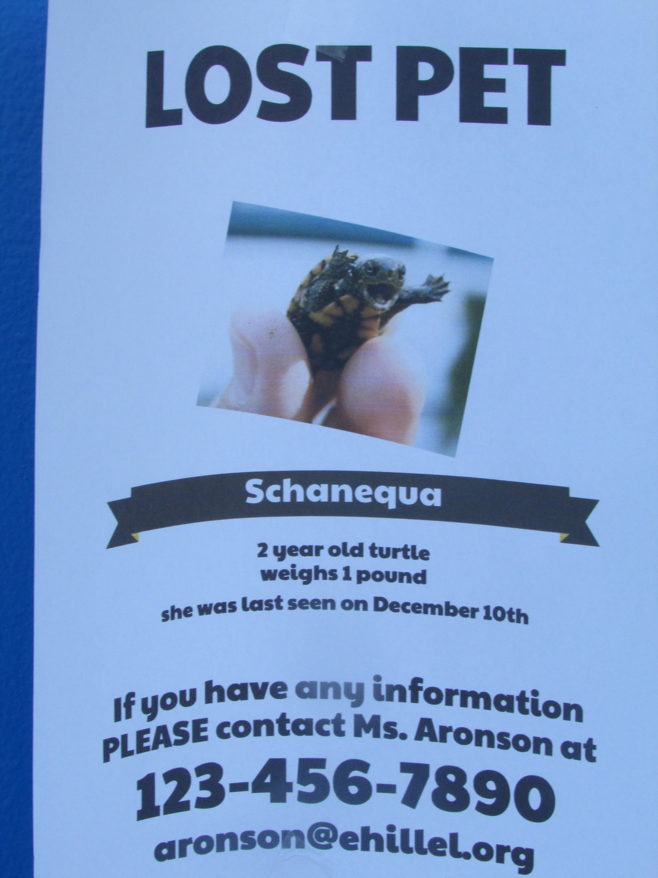
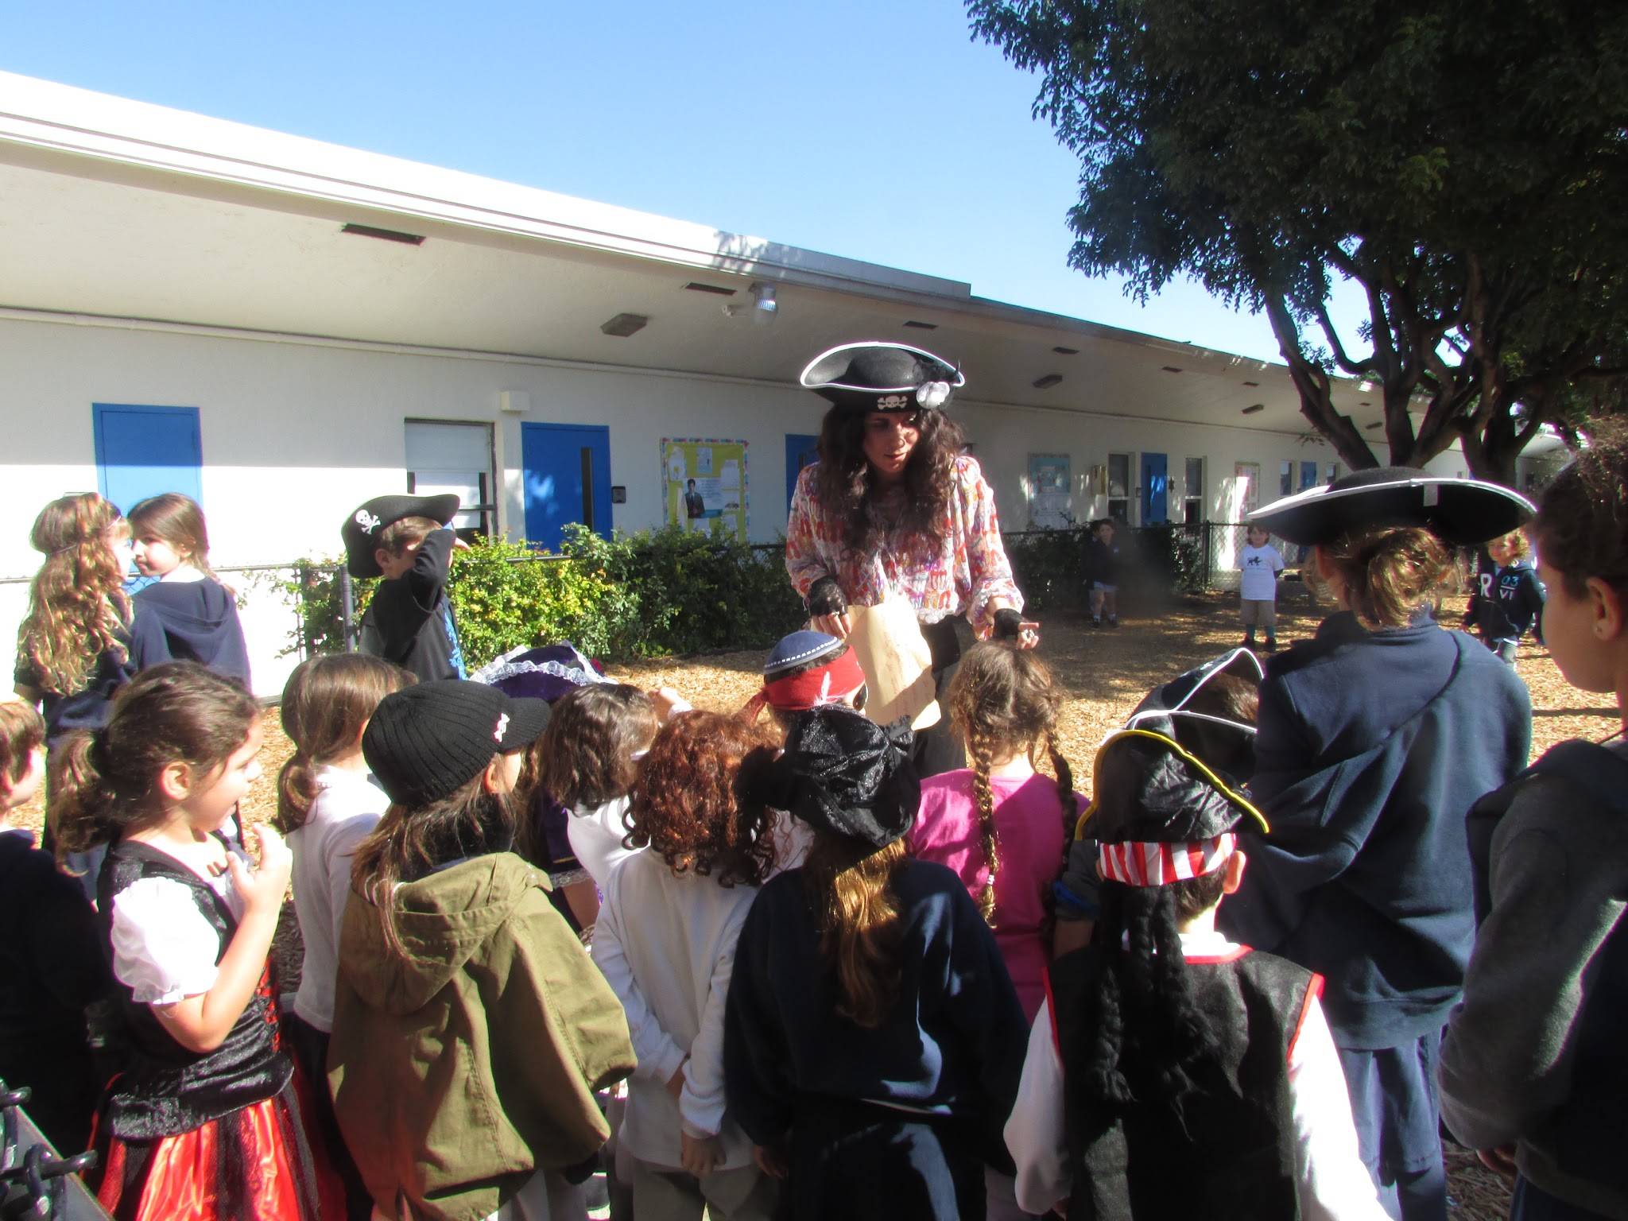

Slide 23
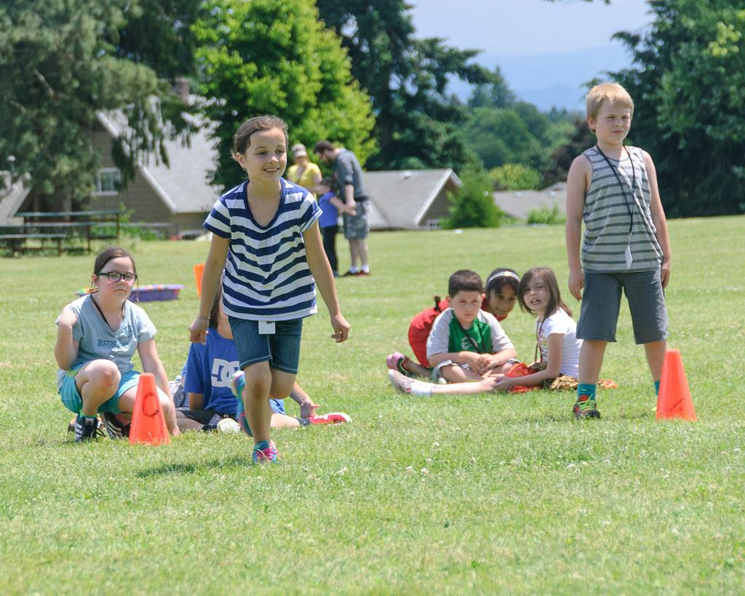

Slide 24
Poetry Field Day 2013
In honor of poetry month, we had poetry field day.
*Each child made a poetry notebook with sports poems
*Poems were “mysteriously appearing” around the school (including bathrooms)
*Video, tech, book, field day, slam, read, write

Slide 25
Poems
BOUNCING BASKETBALL
bounce, dribble, bounce
stumble, thud, stop
bounce, bounce, take aim
into basket drop
rebound, dribble, bounce
jump, reaching, stretch
smack, hit back-board
thump, weeping, retch
umpire whistles, calls ‘foul’
coach mumbles, players grumble
shrill blast, time-out’s past
back to task, run, rumble
Battle Over the Diamond
pitcher cool, cocky examining, taunting, throwing batter1, batter2, pinchhitter, batter3 readying, waiting, swinging ready, missed catcher

Slide 26
Sports/Ruach (spirit) 2015
Students asked for another sports day!
Our theme is sports/Ruach and we are building the idea of teamwork, sportsmanship, perseverance, and more!

Slide 27
Sample activities
Weightlifting poems, lesson: try, try again, try different!
Basketball Belles- everyone can play, rules change
Pete the Cat- if you mess up, keep going, it’s all good!

Slide 28
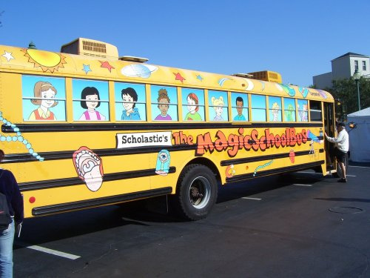

Slide 29
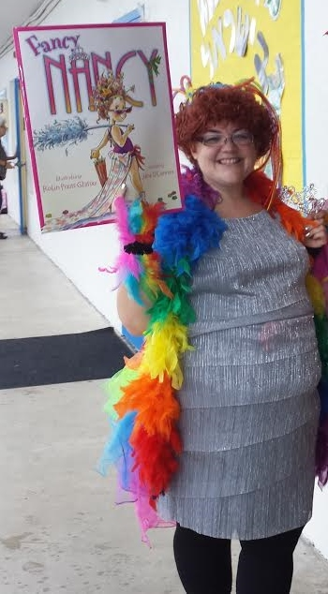
Reading with the Stars
Teachers chose an author/
character to present.
Students could also dress up!

Slide 30
Stars included: Pinkalicious, Fancy Nancy, Viola Swamp, Ms. Frizzle, Amelia Bedelia, Elephant and Piggie, Pigeon, Naked Mole Rat, Johnny Appleseed, Cat in the Hat, and more!

Slide 31
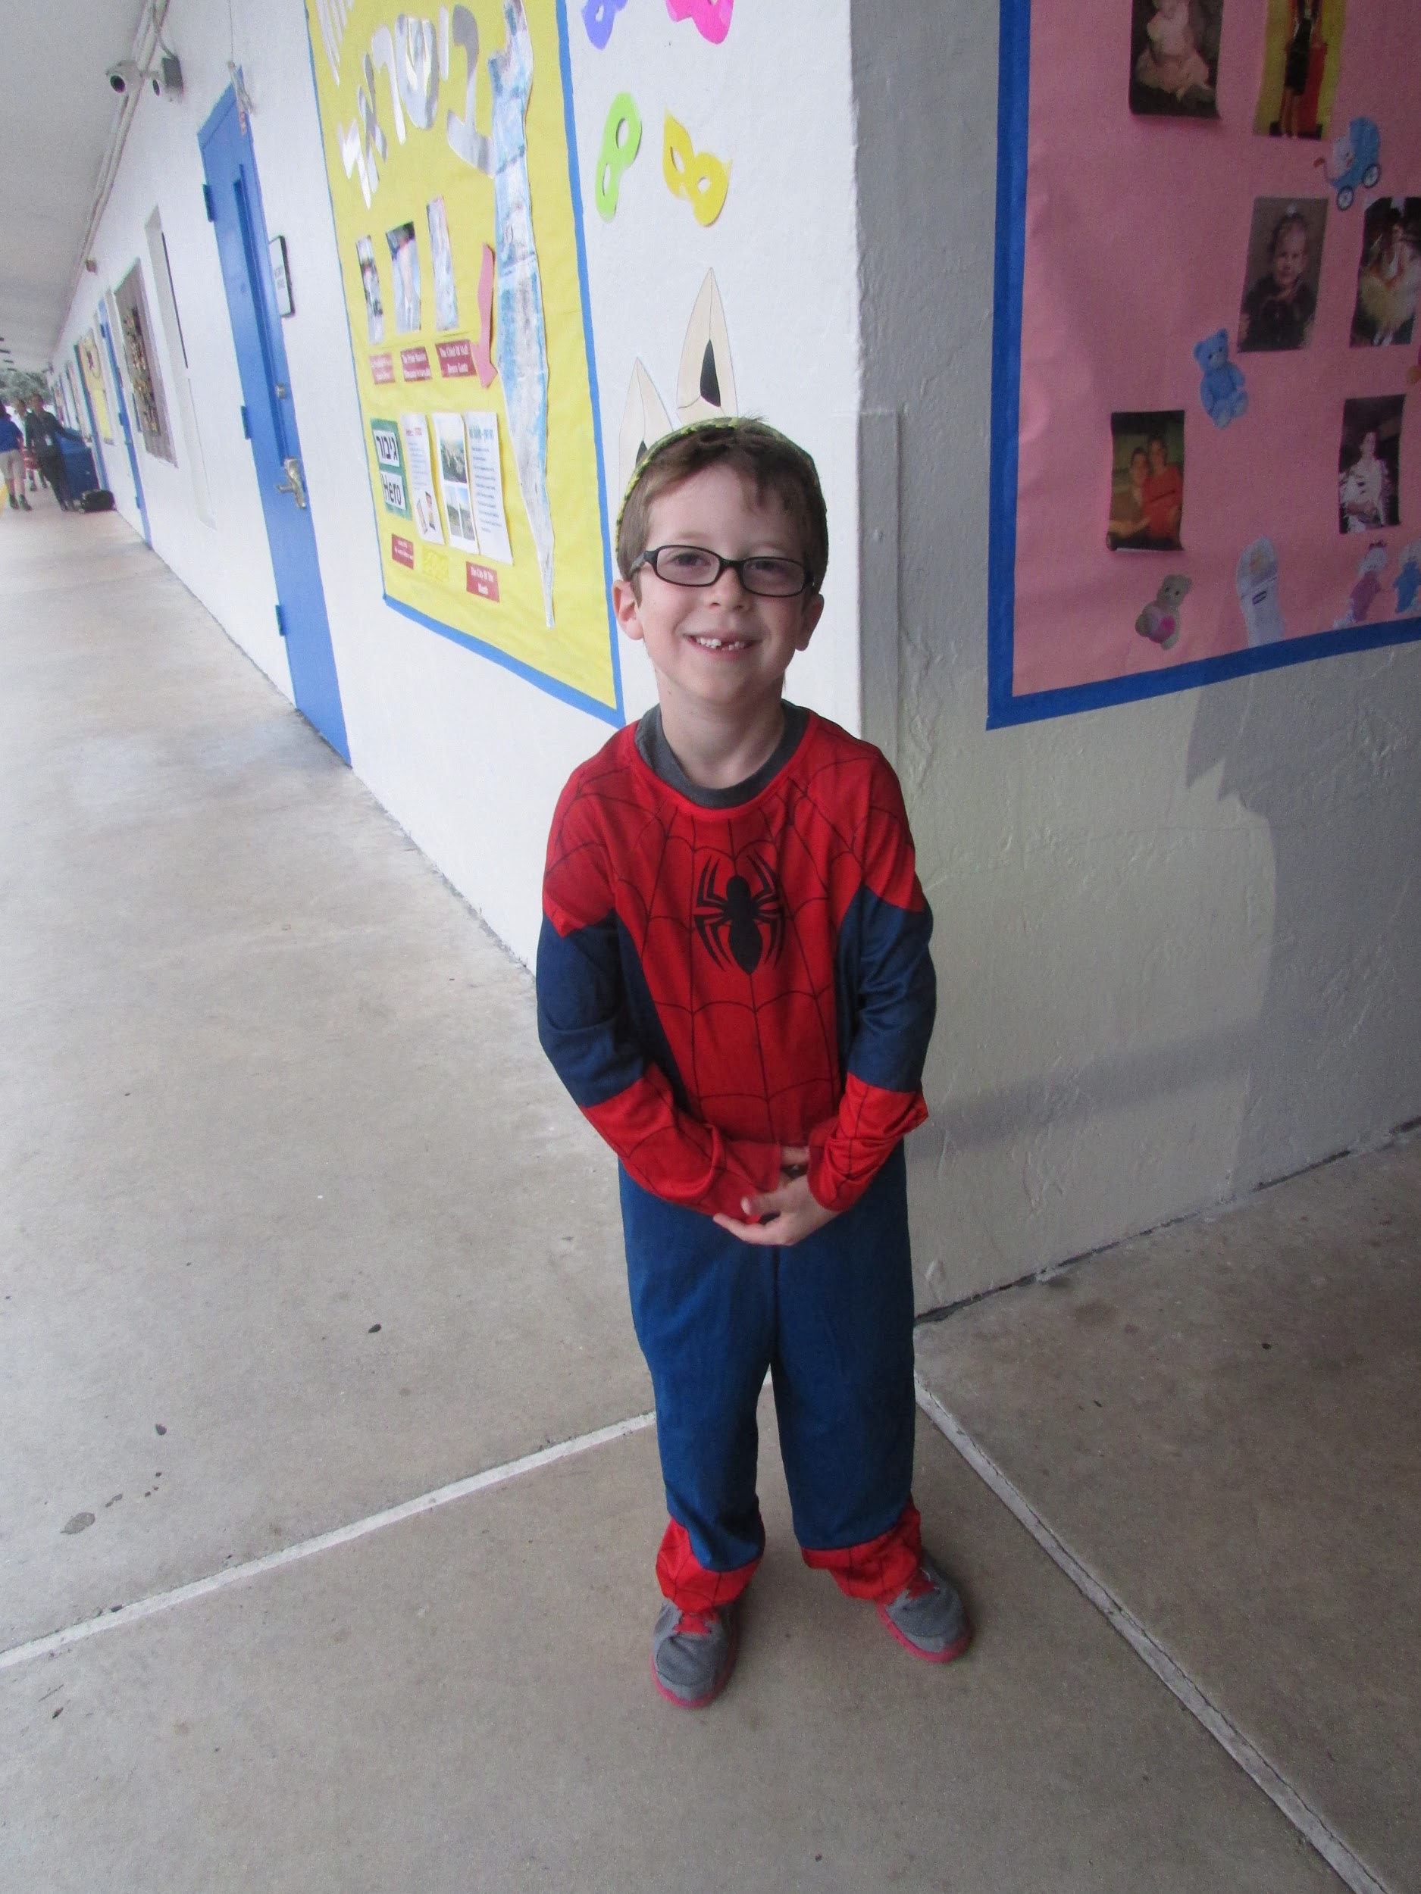
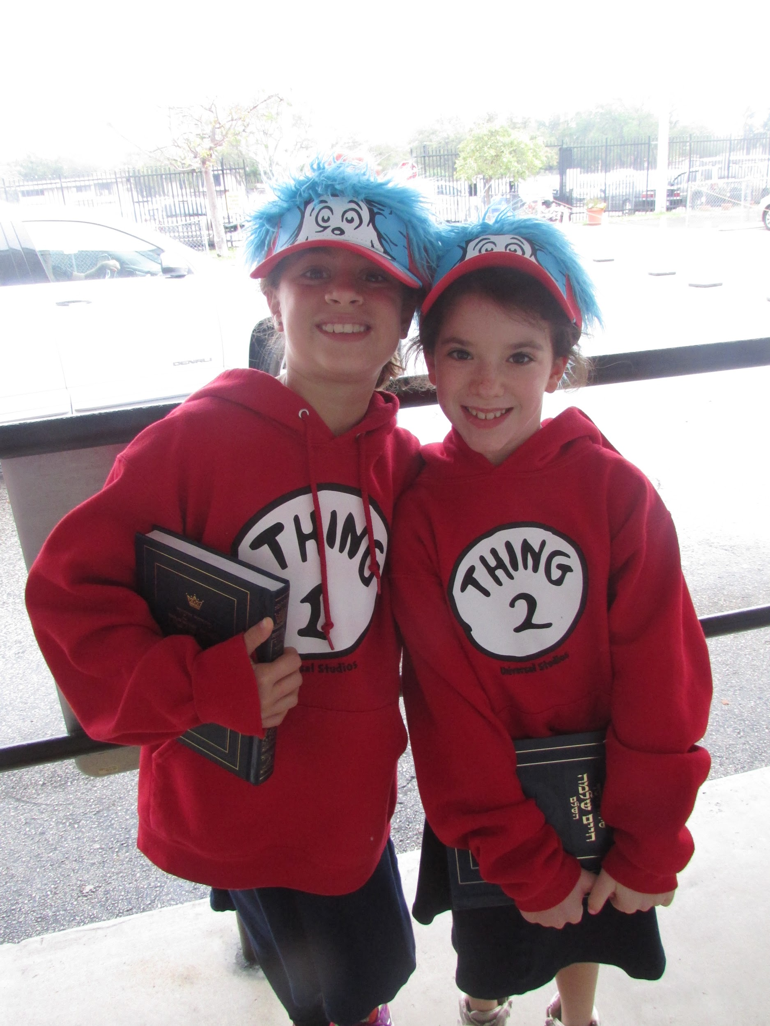
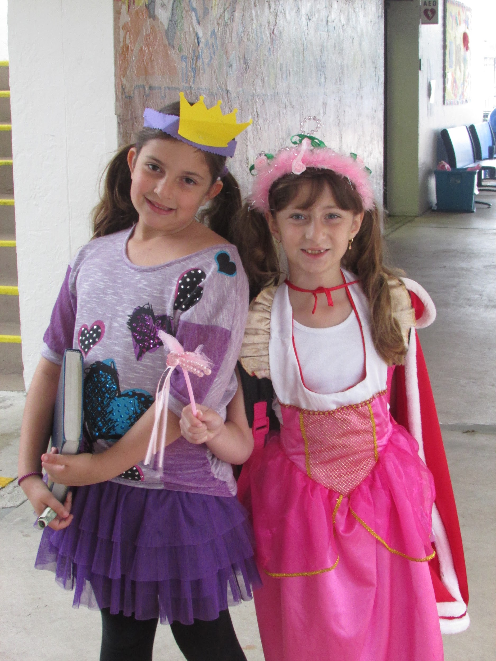
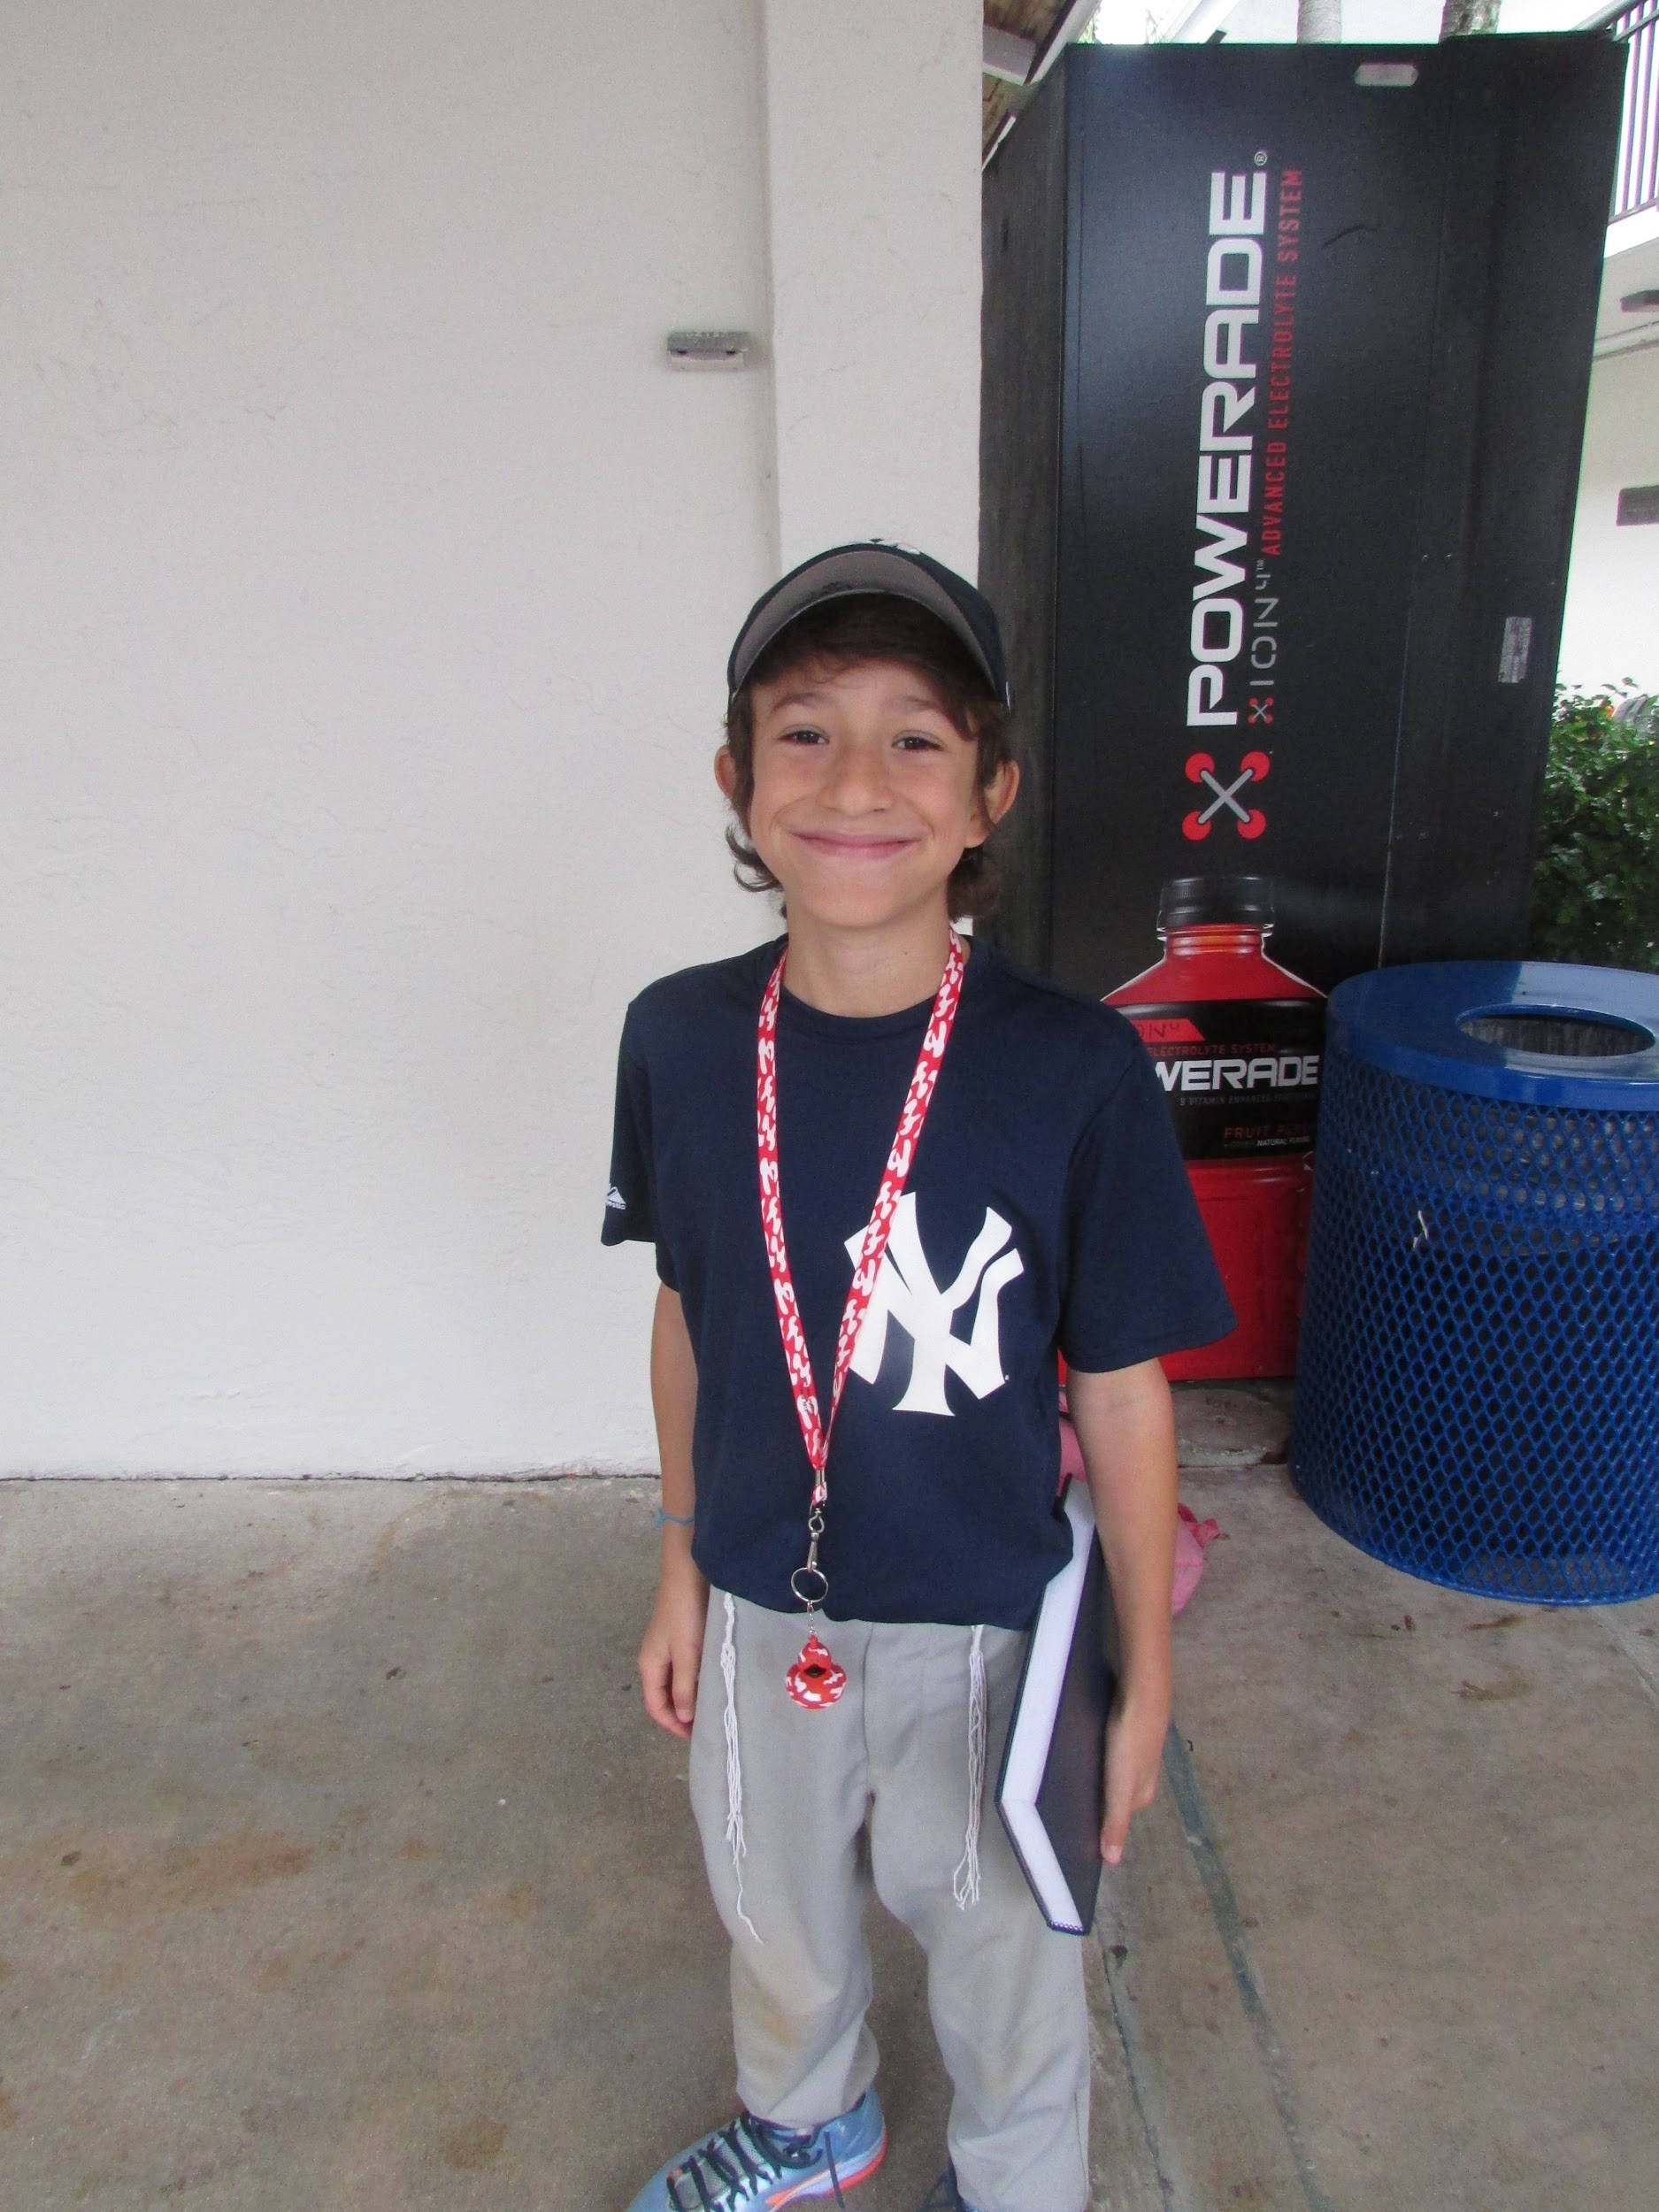
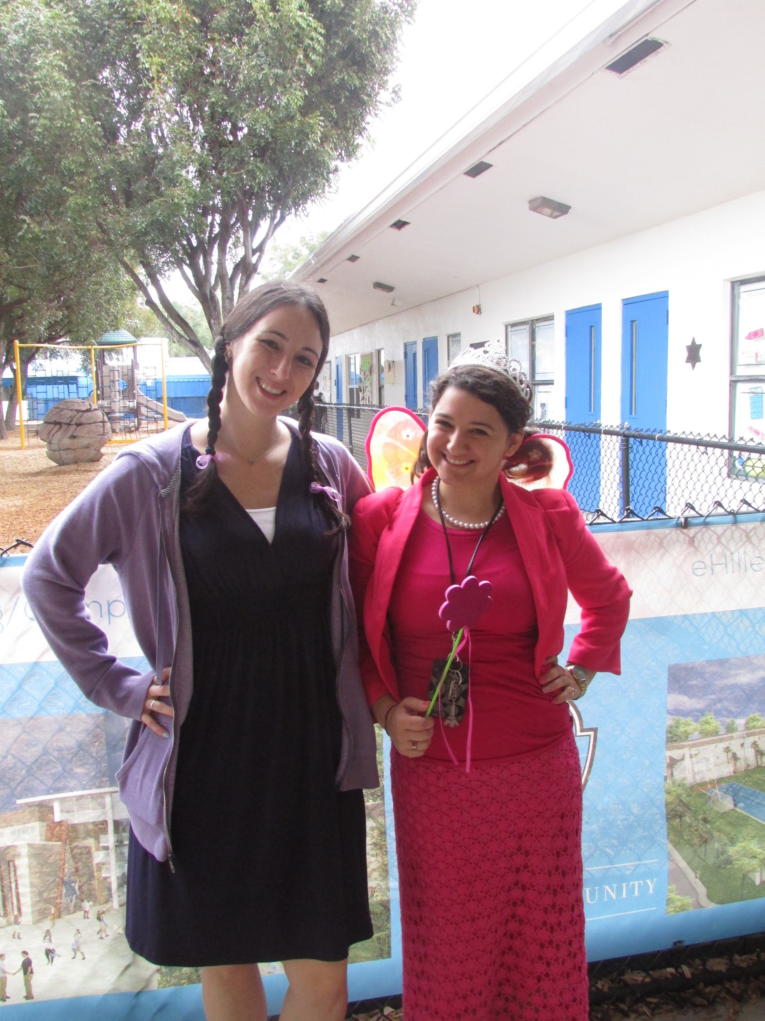
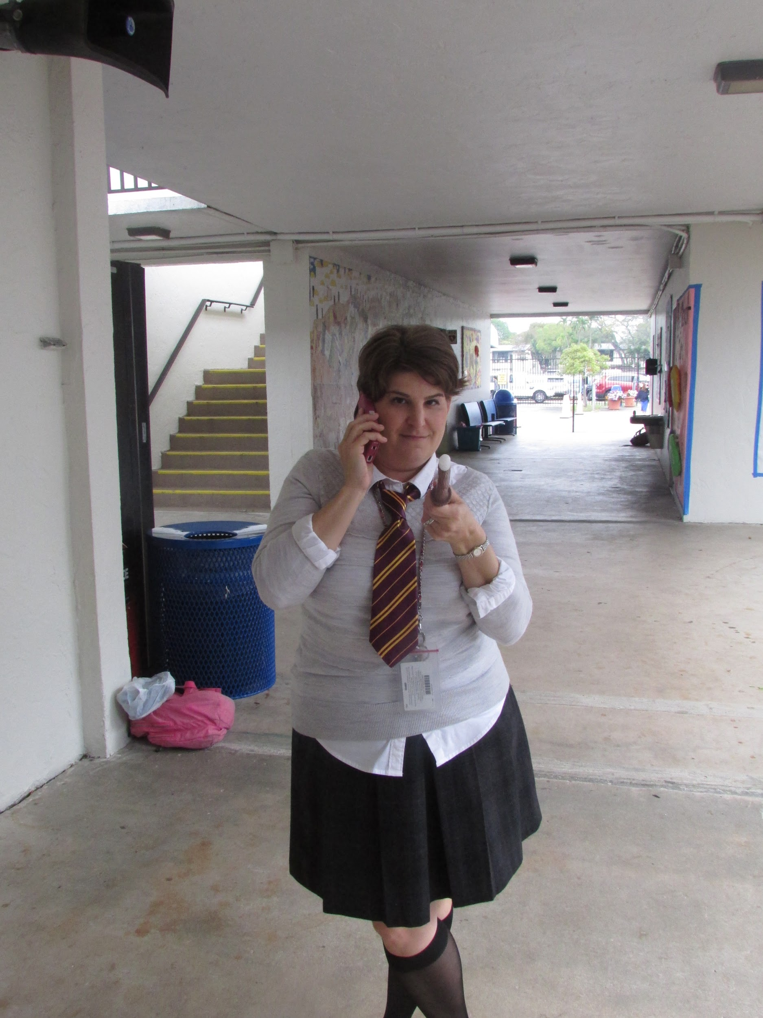
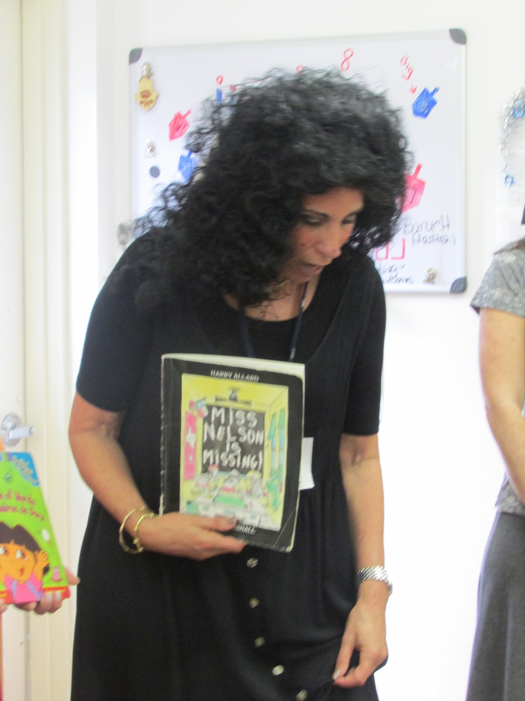
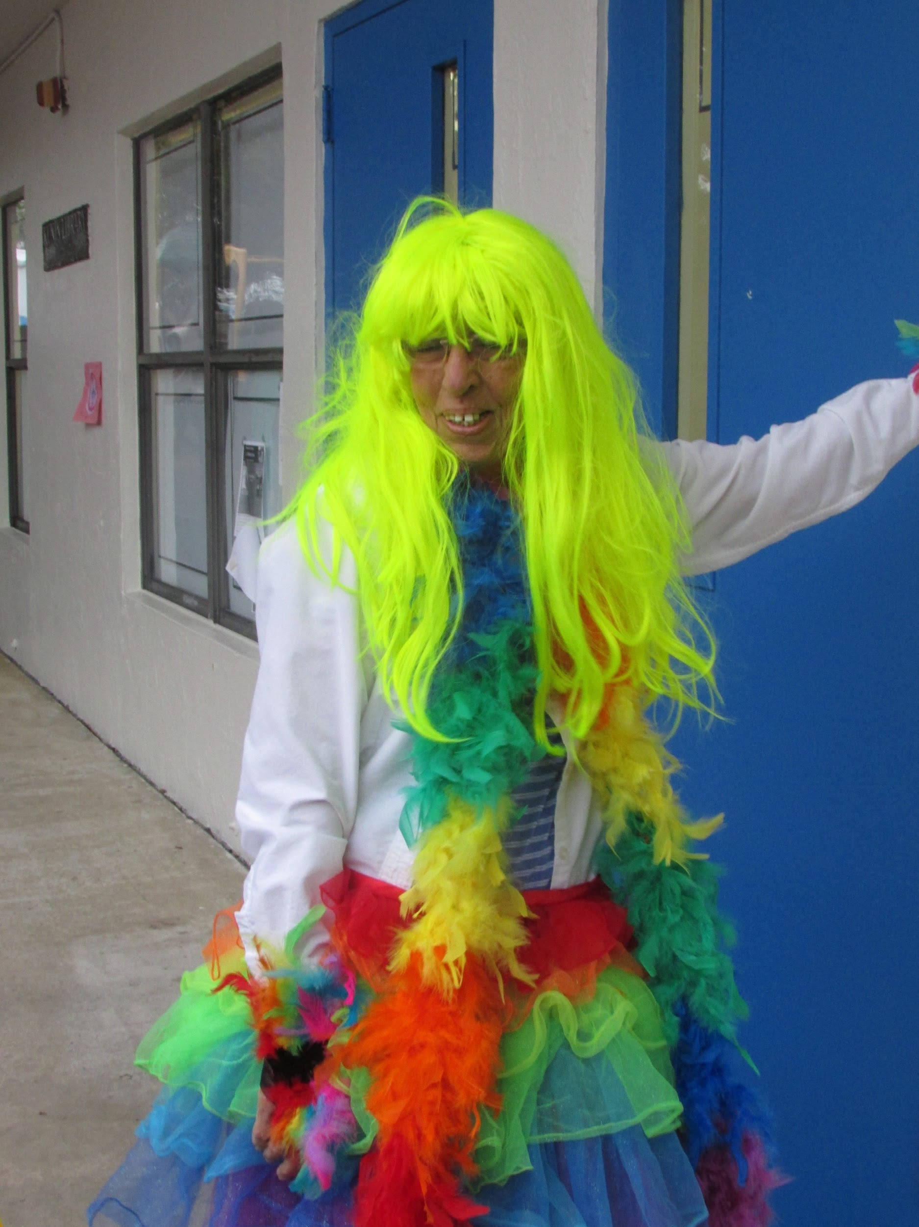

Slide 32
Questions?
Ideas?

