Slide 1
Technology as a Tool
Using Technology to Add Spice
to Your Teaching
www.nancypenchev.com
www.nancypenchev.edublogs.org
nancypenchev@gmail.com
Twitter: @penchevable

Slide 2
Nancy Stone Penchev
18 years classroom experience in grades K-5
Lifelong learner
An Archeolibrainologist
Children’s book enthusiast
Blogger
Passionate sharer of instructional technology
Best daughter, sister, aunt EVER, pretty good wife

Slide 3
And a person never scared to say...
Uhhh I don't know, let's figure it out

Slide 4
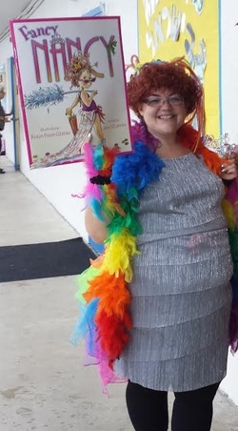
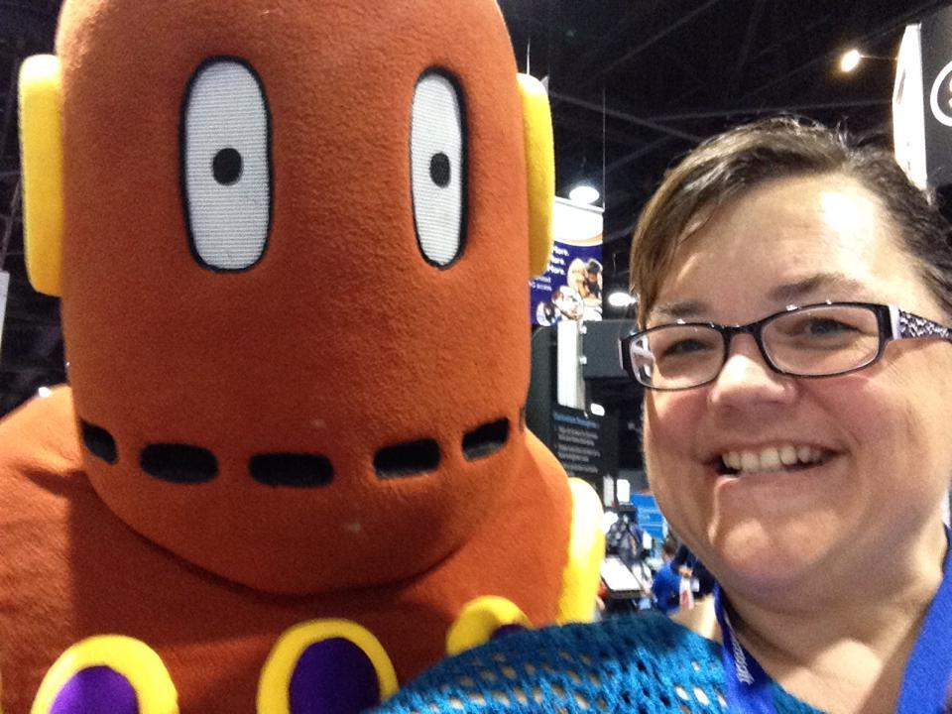
And yes, I am THAT teacher

Slide 5
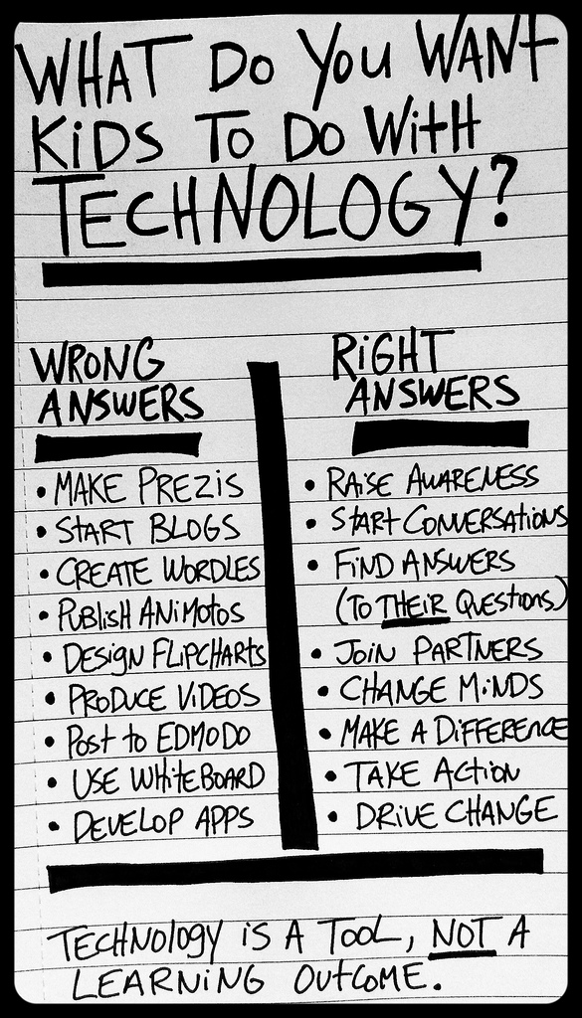

Slide 6
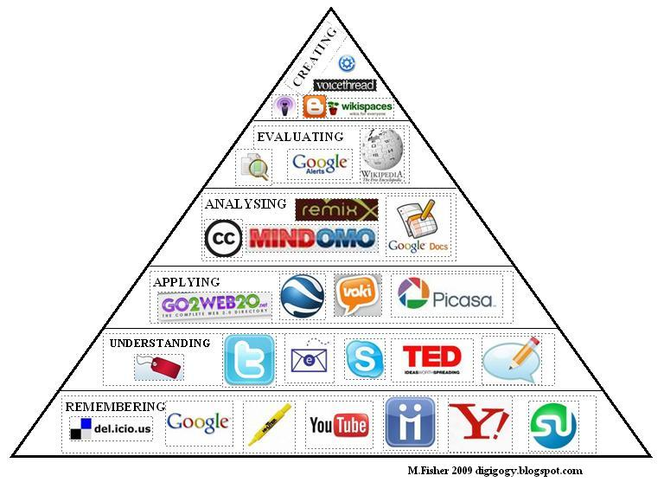

Slide 7
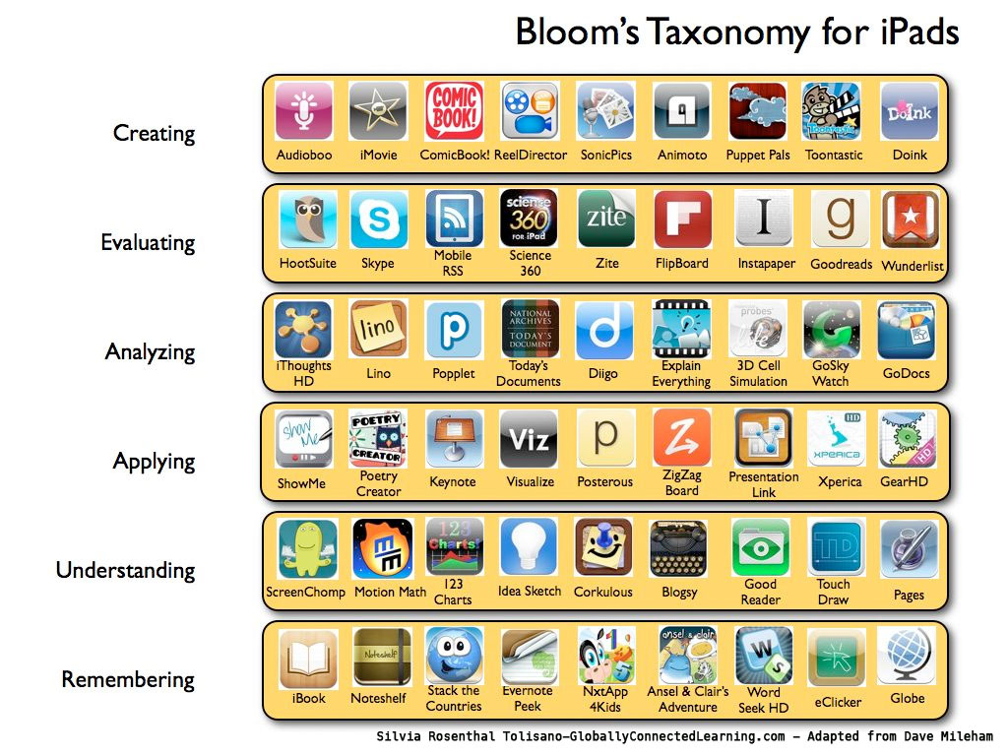

Slide 8
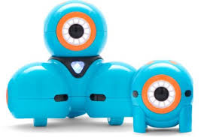
Commercial
Dash and Dot
Robots to teach
simple to advanced
programming.
www.makewonder.com

Slide 9
Lesson planning
You would never start planning a lesson by saying I really want my kids to create a poster this week, what can I teach them. Similarly, you should never start planning a lesson focused on the technology. Decide your objective and your goal, then see where tech can be added so it flows with the lesson, not distract from it.

Slide 10
History lesson 3rd grade (PA)
5.1.3.F: Identify state symbols, national symbols, and national holidays.
Identify STATE symbols
Animal: Whitetail Deer
Bird: Ruffed Grouse
Dog: Great Dane
Fish: Brook Trout
Flag of Pennslyvania
Flower: Mountain Laurel
Motto: "Virtue, Liberty and Independence"
Nickname: Keystone State

Slide 11
Lesson plan
Read from History book
Read Celebrating Pennsylvania, Good Night Pennsylvania, Little Pennsylvania, and K is for Keystone children’s books
Art activities
build the flag from recycled materials
Cut and paste pictures of symbols and create class poster

Slide 12
Tech Spice
Research using AtoZ and State Kids site
Create a Popplet brain map to show the names and pictures of state symbols and compare to another state
Create a ScratchJr coding program to share the animal representatives
Use Pic Collage to make a poster of the symbols
Educreations movie with symbols and kids voices to share what they have learned.

Slide 13
Other standard addressed with Tech Spice
CCSS.ELA-LITERACY.W.3.7 Conduct short research projects that build knowledge about a topic.
CCSS.ELA-LITERACY.W.3.6 With guidance and support from adults, use technology to produce and publish writing (using keyboarding skills) as well as to interact and collaborate with others.
CCSS.ELA-LITERACY.RI.3.3 Describe the relationship between a series of historical events, scientific ideas or concepts, or steps in technical procedures in a text, using language that pertains to time, sequence, and cause/effect.

Slide 14
ISTE Student Standards
1. Creativity and innovation
Students demonstrate creative thinking, construct knowledge, and develop innovative products and processes using technology.
a. Apply existing knowledge to generate new ideas, products, or processes
b. Create original works as a means of personal or group expression
c. Use models and simulations to explore complex systems and issues

Slide 15
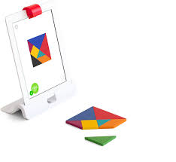
Commercial:
Play Osmo

Slide 16
Adding Tech Spice
*ISSUU
*Edmodo
*Animoto
*GoAnimate
*Powtoons
*Blabberize
*MADlearn

Slide 17
Adding Tech Spice
*Glogster
*Voicethread
*Wordle
*Big Huge Labs
*Popplet
*Weebly
*Social Media

Slide 18
Commercial:
Educlipper

Slide 19
Adding Tech Spice APPs
*Educreations
*Explain Everything
*PerfectVideo
*ChatterKid
*30Hands

Slide 20
Adding Tech Spice APPs
*Sock Puppets
*PixnTell
*Tellagami
*Book Creator
*Doodle Buddy

Slide 21
Adding Tech Spice APPs
*Popplet lite
*Telestory
*PicCollage
*Phonto

Slide 22
Coding
*ScratchJr
*BeeBot
*The Foos
*Hopscotch
*Daisy the Dinosaur
*Floors- ooooooo!!!!!!

Slide 23
Commercial:
Gmail/Googledrive

Slide 24
Low Tech/No Tech options
For when tech isn’t available or convenient

Slide 25
Social Media walls
Create a social media wall for students to post character status updates, create character profiles, and make connections between characters in the books they are reading.
Can also be used with historical figures or famous scientists/mathematicians.

Slide 26
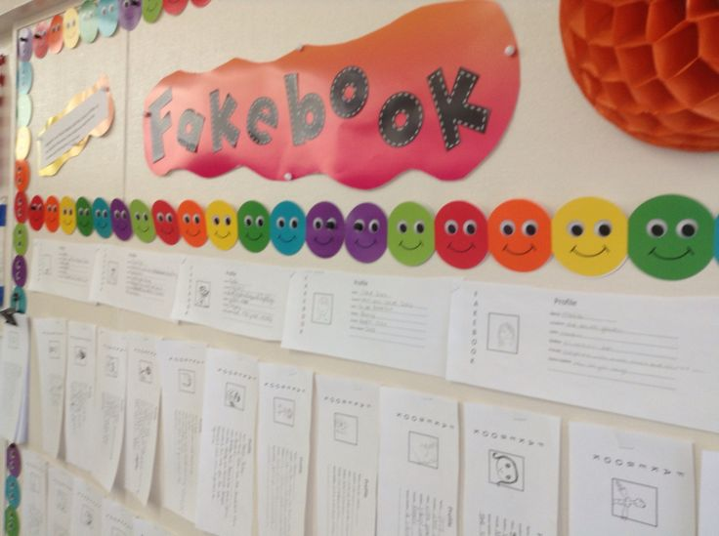

Slide 27
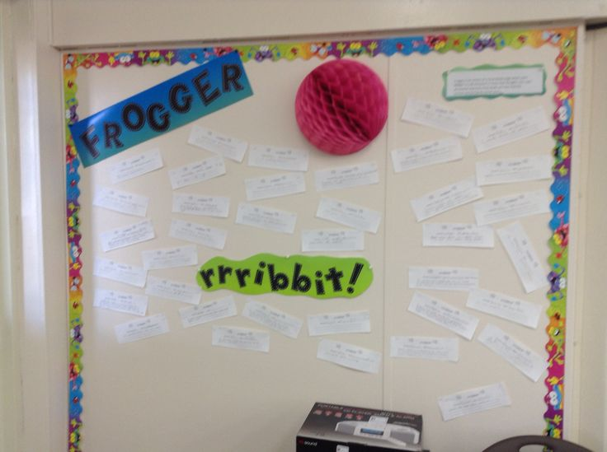

Slide 28
Foldable/Popout report
Have students create a visual report with a folded piece of construction paper, then have them record their information. (Think a singing birthday card.)

Slide 29
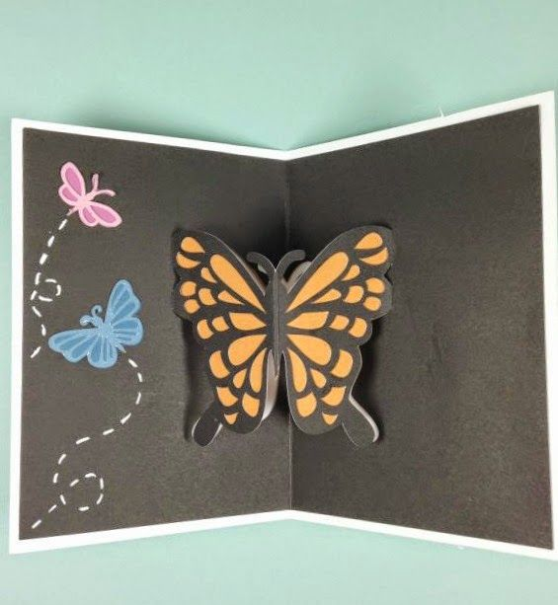

Slide 30
Photography
Photography can be used in many ways to expand on the subject matter.
Movies

Slide 31
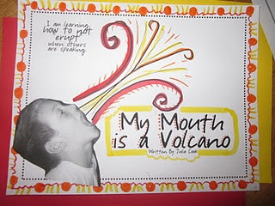

Slide 32
Sticky Blogs
A teacher/student selects a topic to discuss and writes the idea on the top of a chart paper that is attached to a table. Students use sticky notes to respond and reply to the topic.

Slide 33
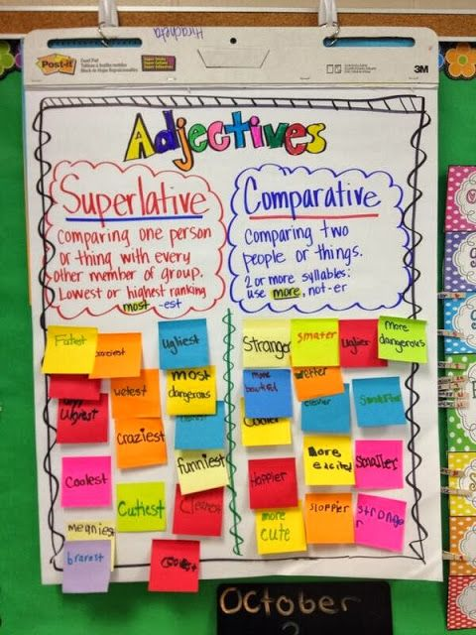

Slide 34
Polls
Poll questions are posted, students answer in many ways:
*sticky note
*picture
*object

Slide 35
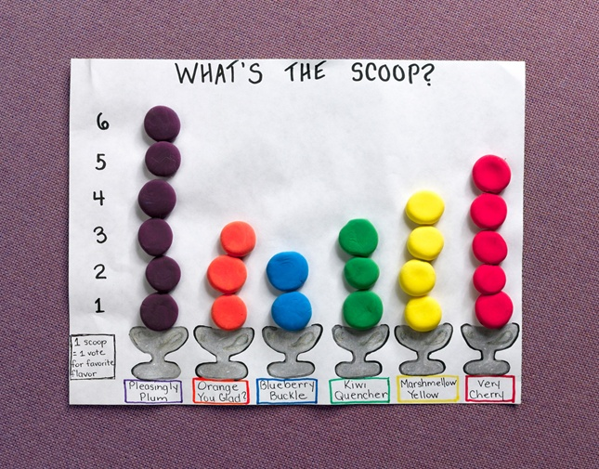
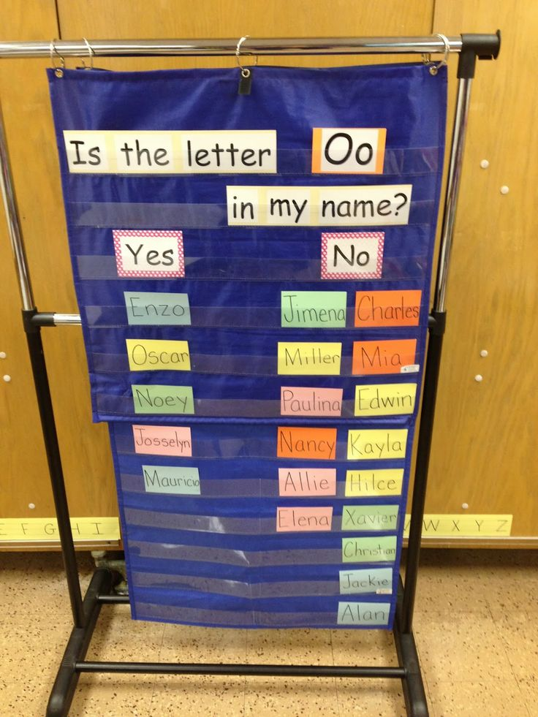
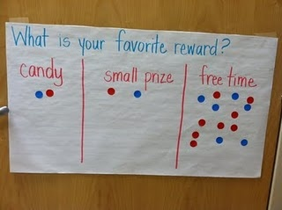

Slide 36
Low Tech/No Tech
Plickers
Plickers is a powerfully simple tool that lets teachers collect real-time formative assessment data without the need for student devices.
Pinterest board for plickers

Slide 37
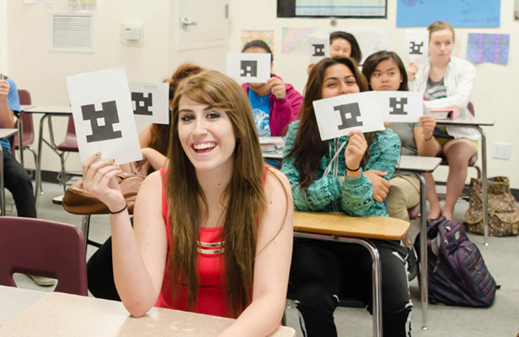

Slide 38
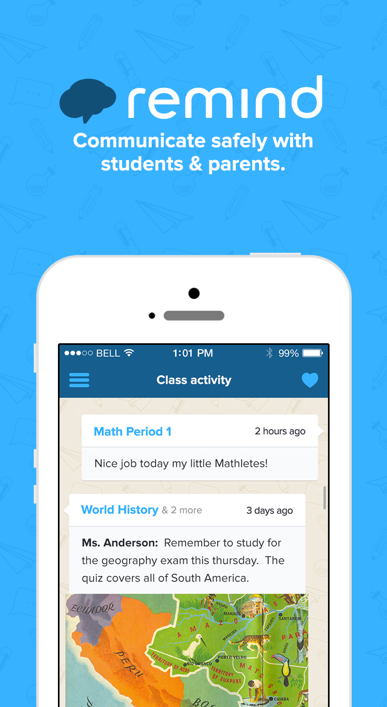
Commercial:
Remind

Slide 39
Inspiration points
www.nancypenchev.edublogs.org
www.freetech4teachers.com
http://blog.web20classroom.org/
http://www.livebinders.com/play/play?id=108629

Slide 40
MOOCs
*Free courses from Canvas
*Free courses from Coursera
*List of MOOCs for K-12

Slide 41
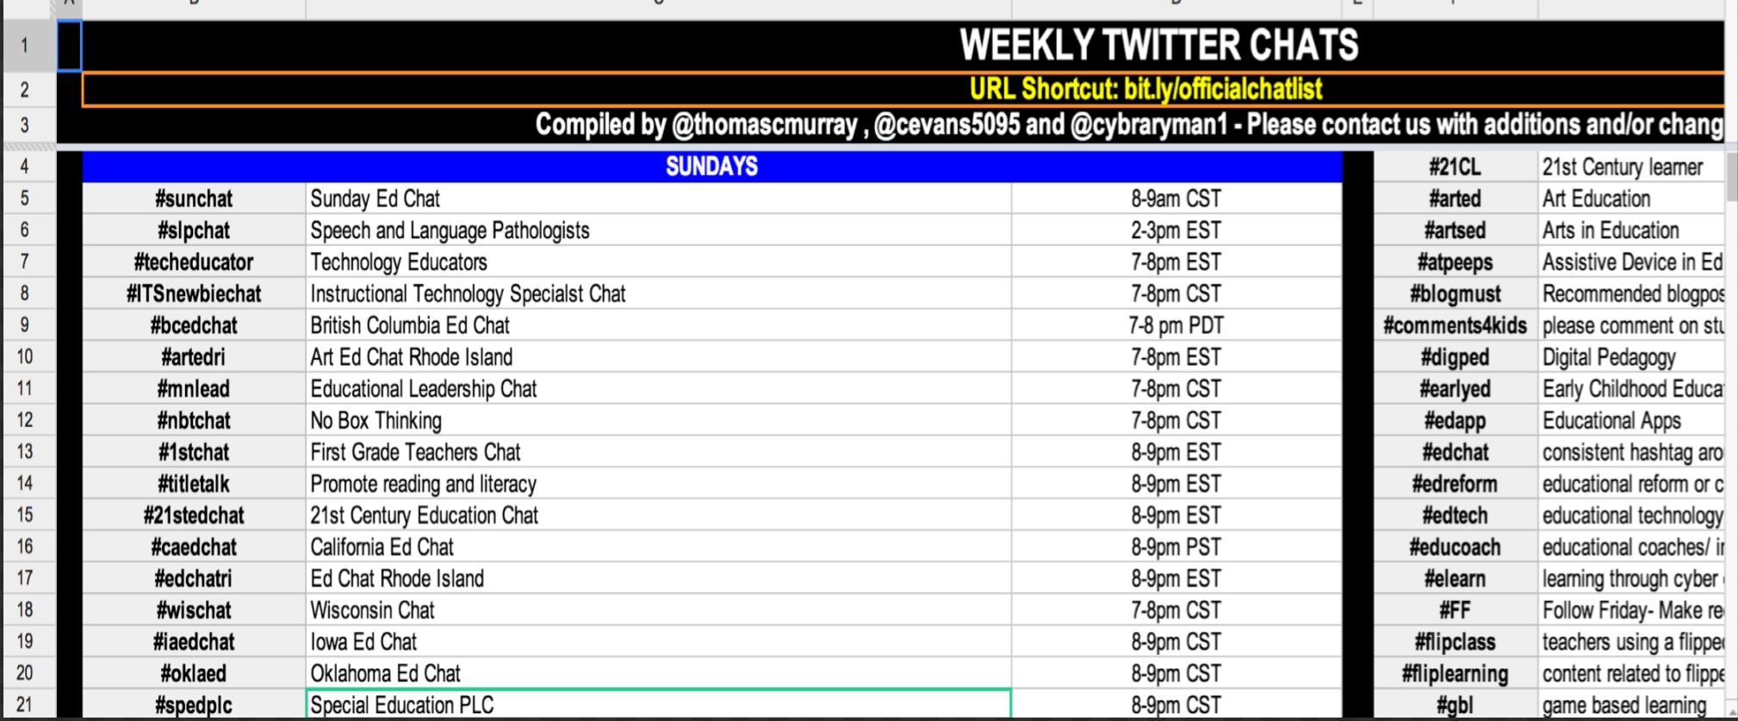
Inspiration- TWITTER!!!!

Slide 42
Check this out...
TweechMe- APP created by a teacher and Twitterati to help teachers figure out how to use Twitter!

Slide 43
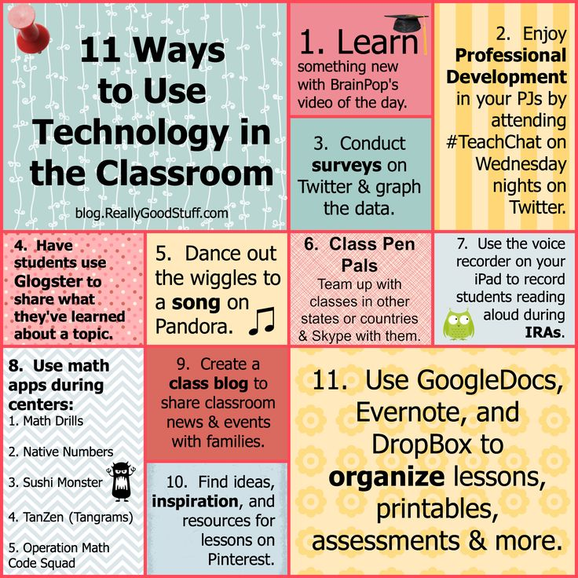
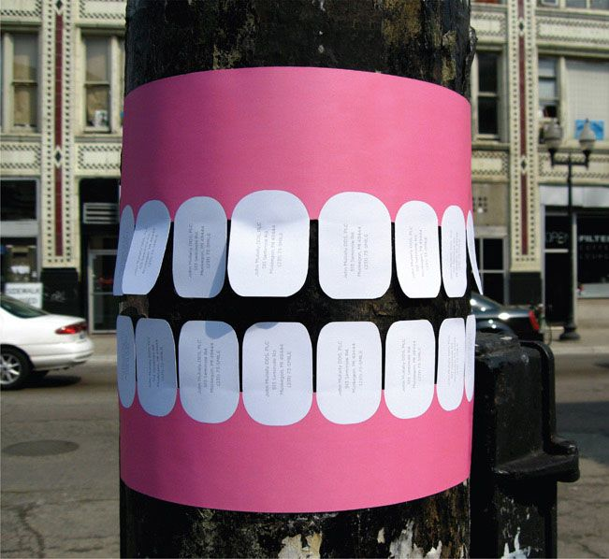
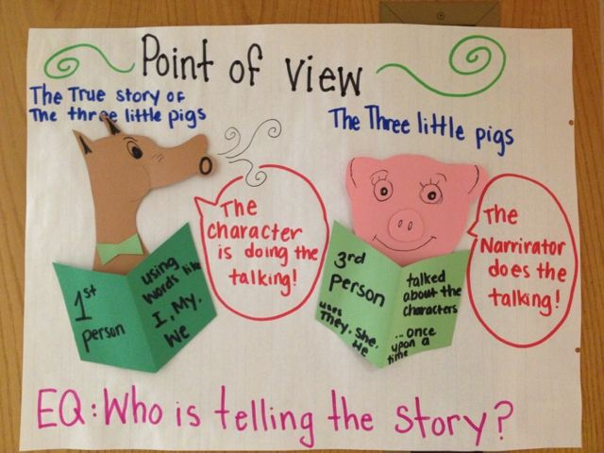
Pinterest
Pinterest

Slide 44
And now...
Questions?

